Slide 1
The Home of Midwest Permaculture
Becky and Bill Wilson

Slide 2
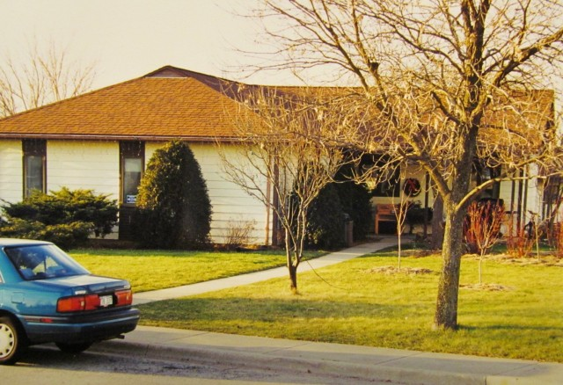

Slide 3
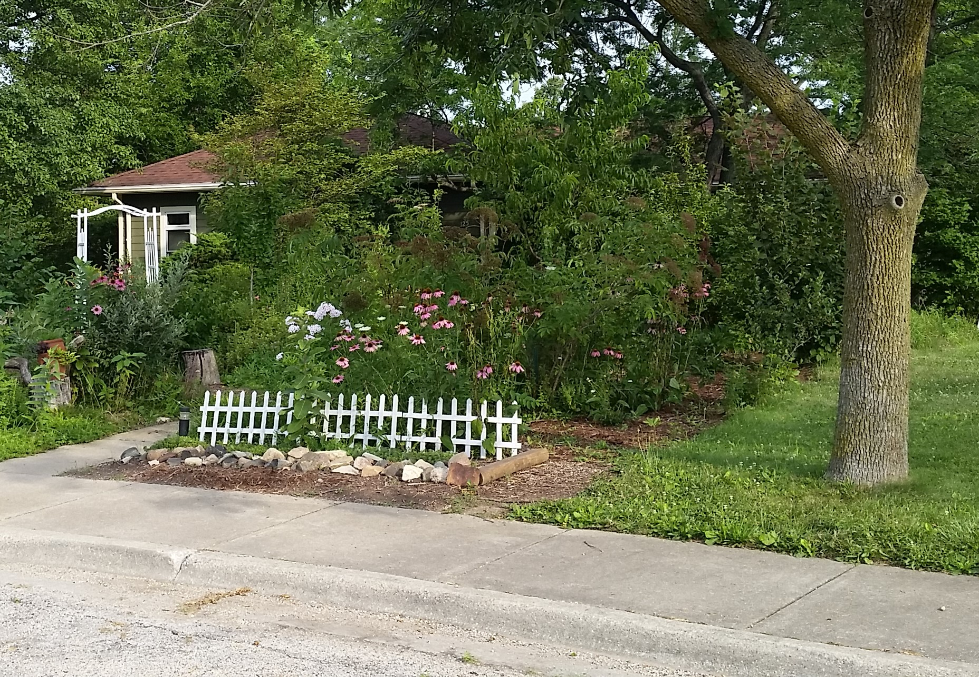

Slide 4
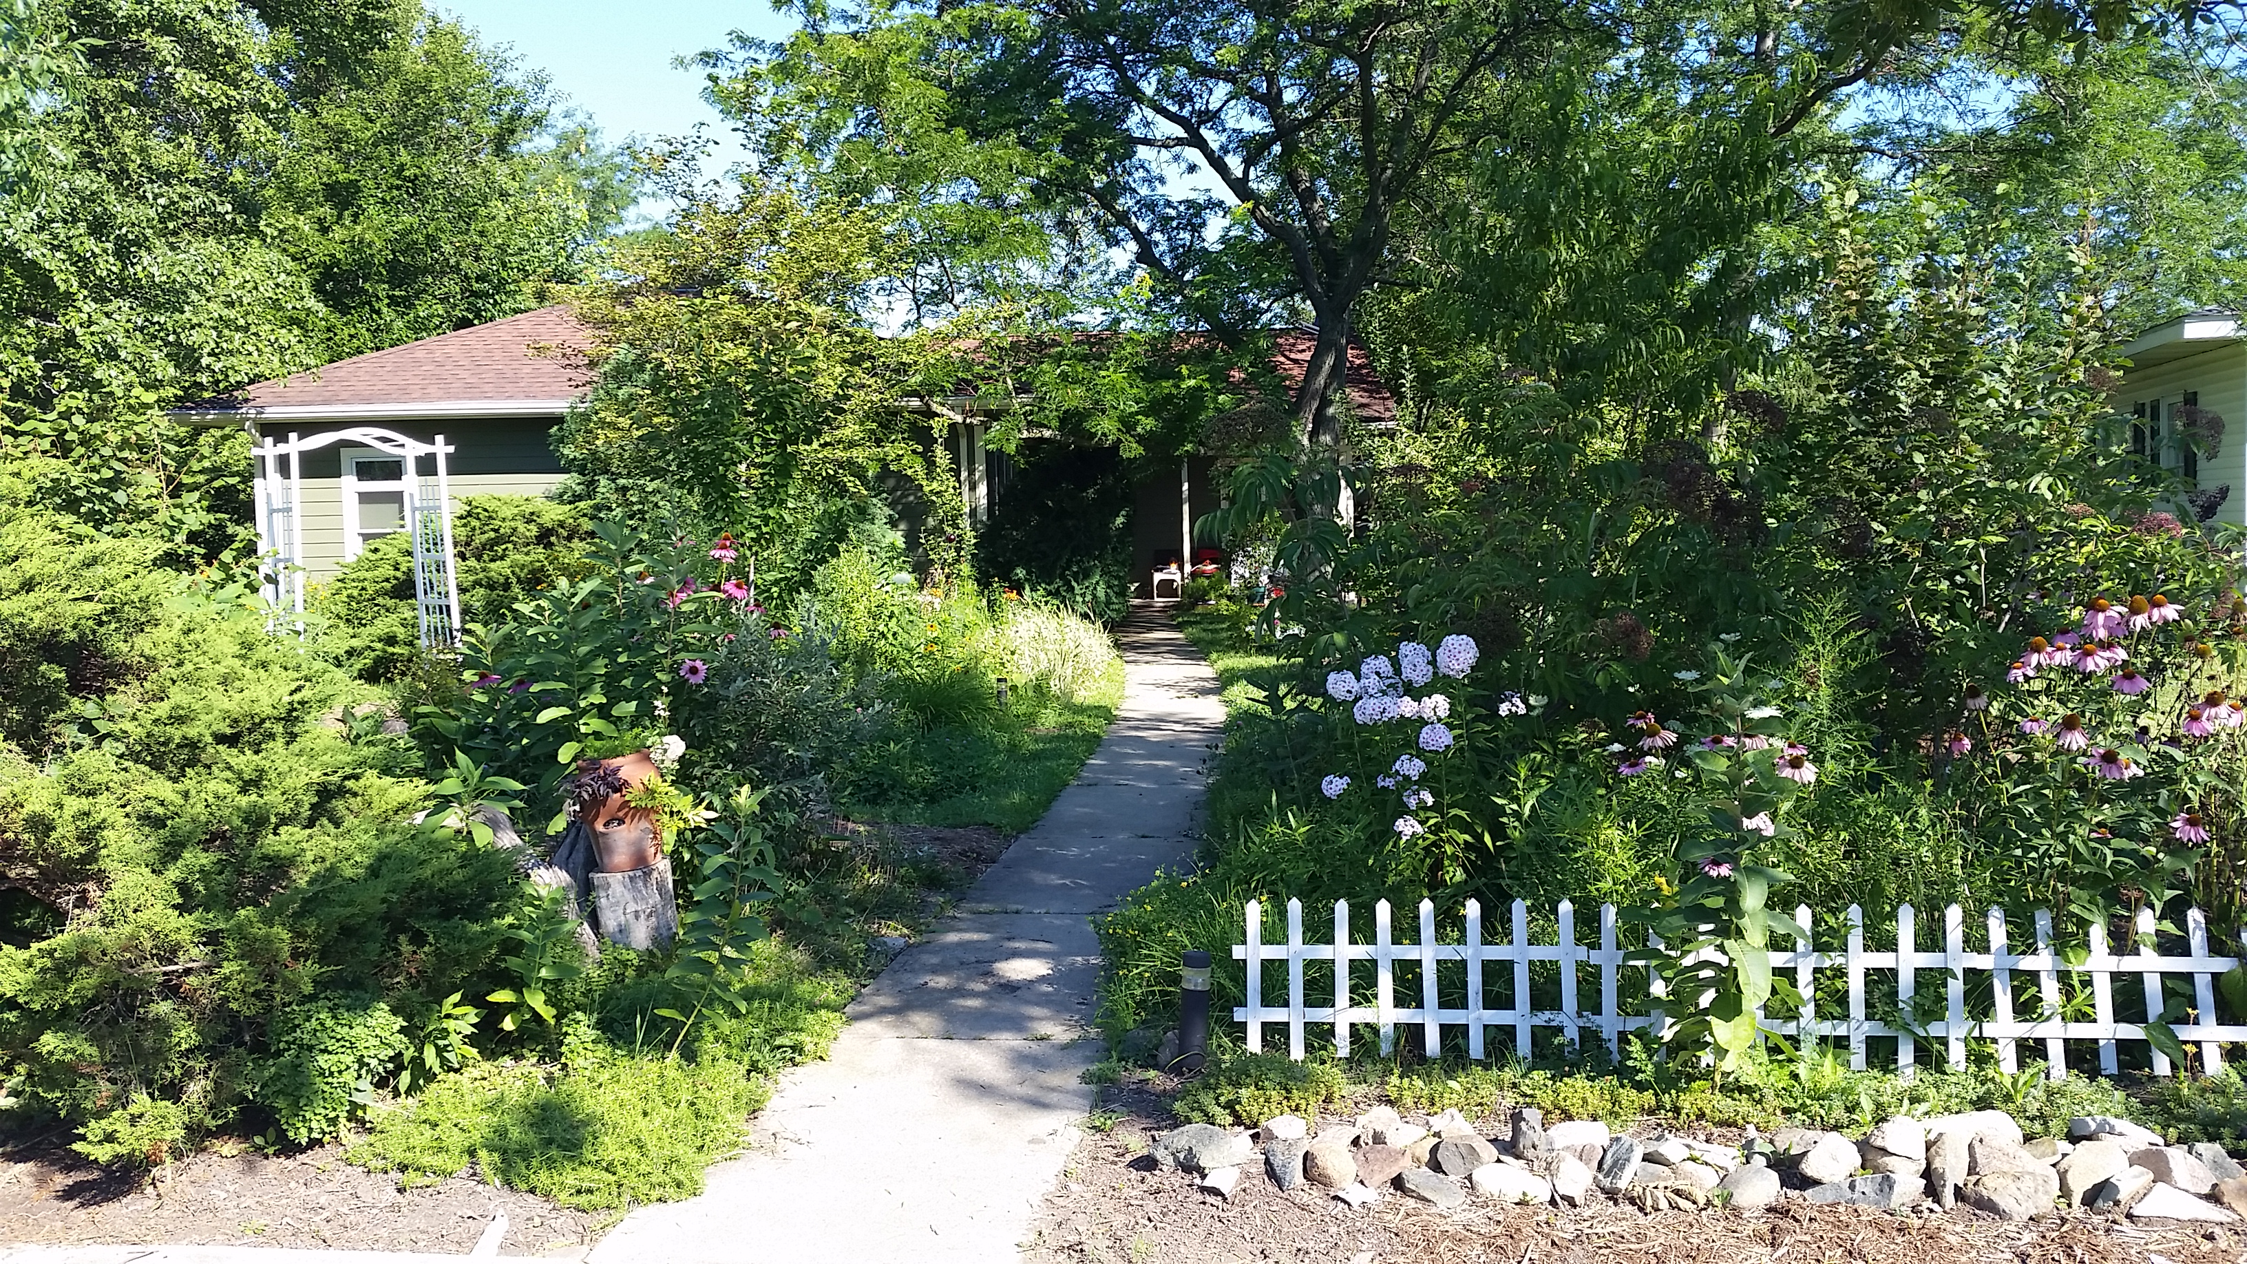

Slide 5
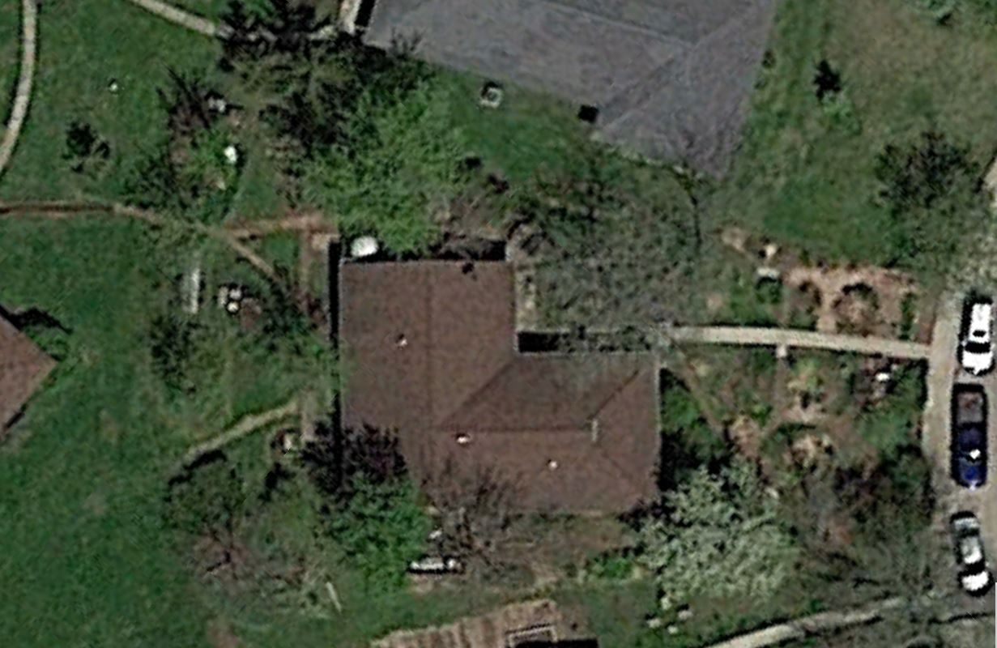
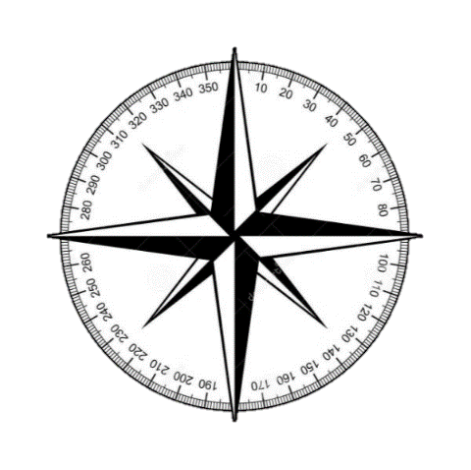
Midwest Permaculture and home of Becky and Bill Wilson Residential Lot @ ¼ acre
Stelle, Illinois USA
Garden Shed
N

Slide 6
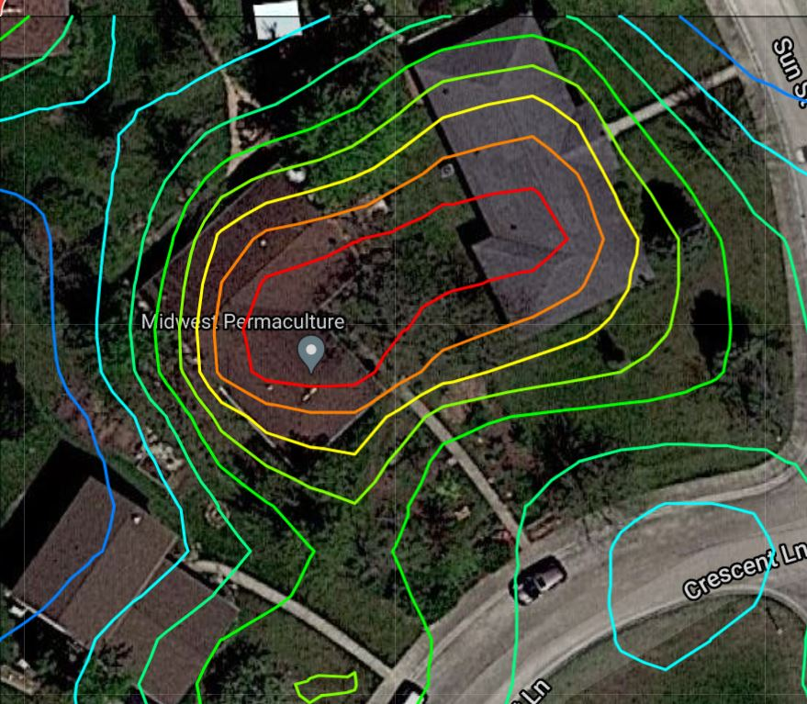
N

Slide 7
N

Slide 9
Front Yard Rain-Garden Design
700 sq.ft.
1
2
Ridgeline
N
1300 sq.ft.
3
Berm with Gooseberries and Currants

Slide 10
Front Yard Rain-Garden Design
Holds 4,000-10,000 Gal. of Rainwater before Overflow
700 sq.ft.
1
2
Ridgeline
1300 sq.ft.
3
Berm with Gooseberries and Currants
Overflow

Slide 11
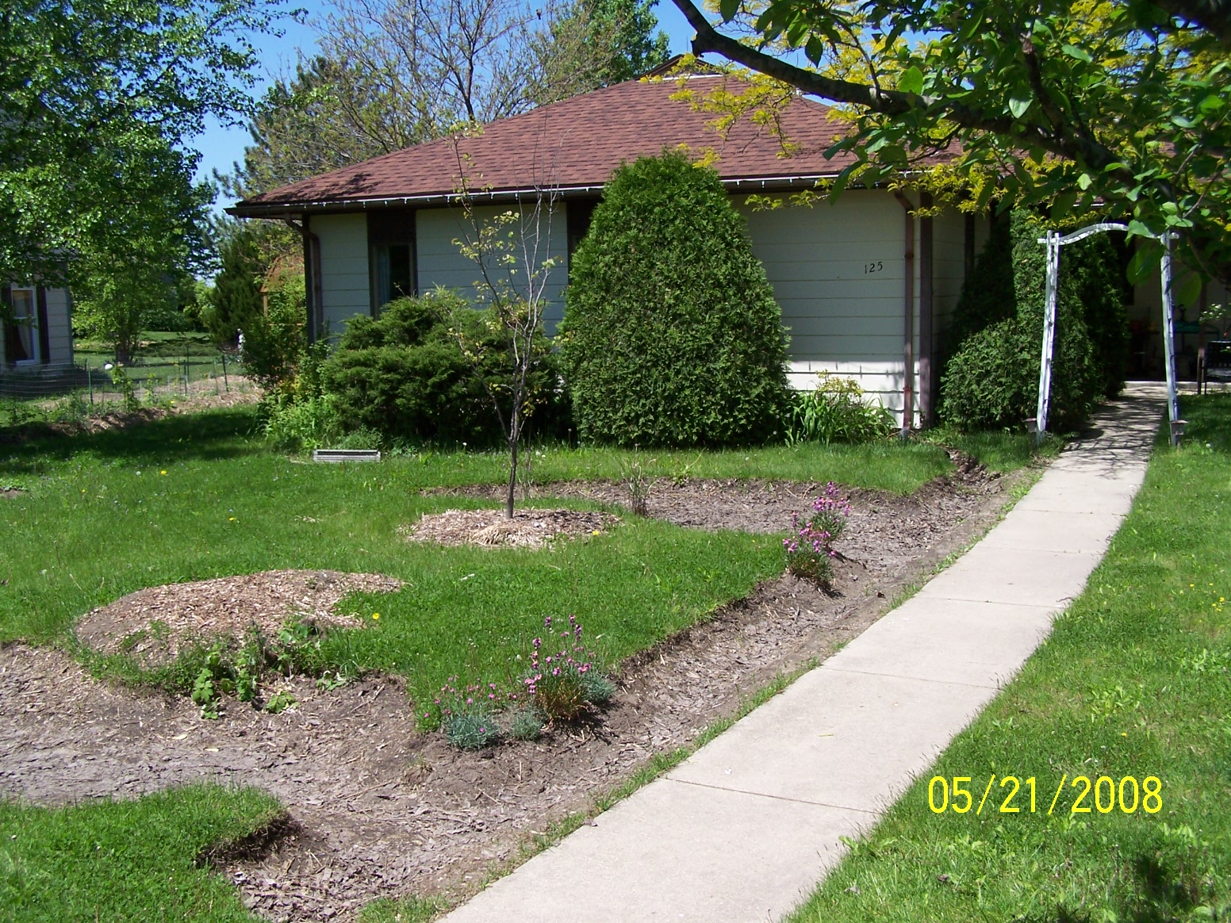
Design Sequence
#1 - Water
#2 - ???

Slide 12
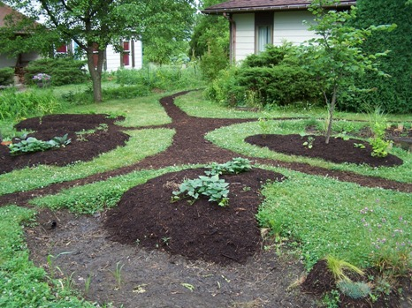
Design Sequence
#1 - Water
#2 – Access (paths)
June 2008

Slide 13
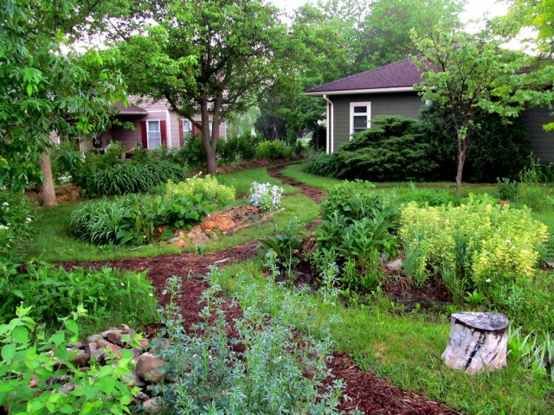
Hazelnut Bushes
June 2013

Slide 14
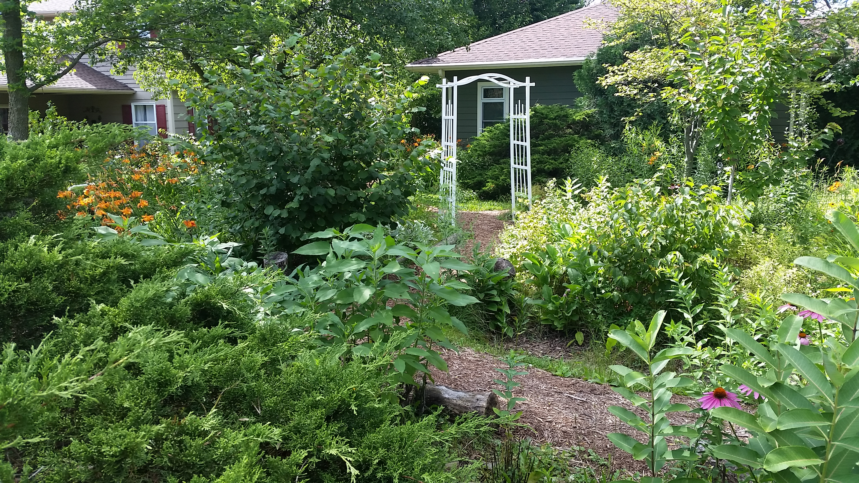
Hazelnut Bushes
June 2017

Slide 15
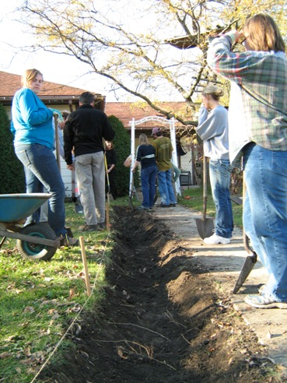
Fall 2007

Slide 16
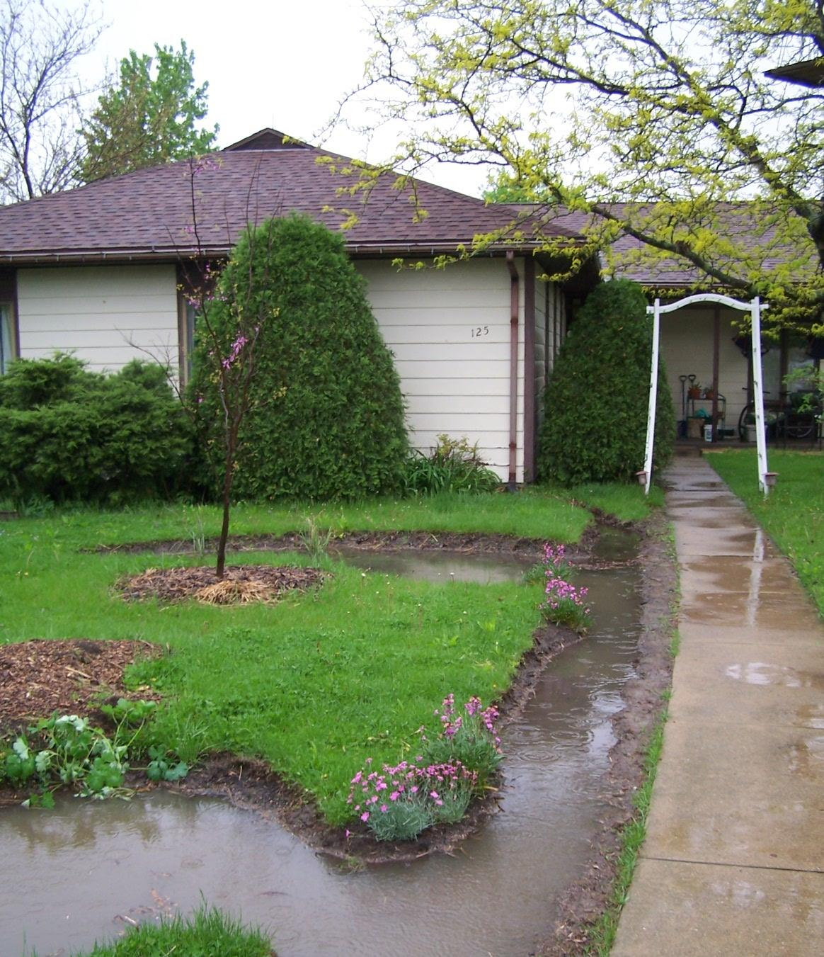
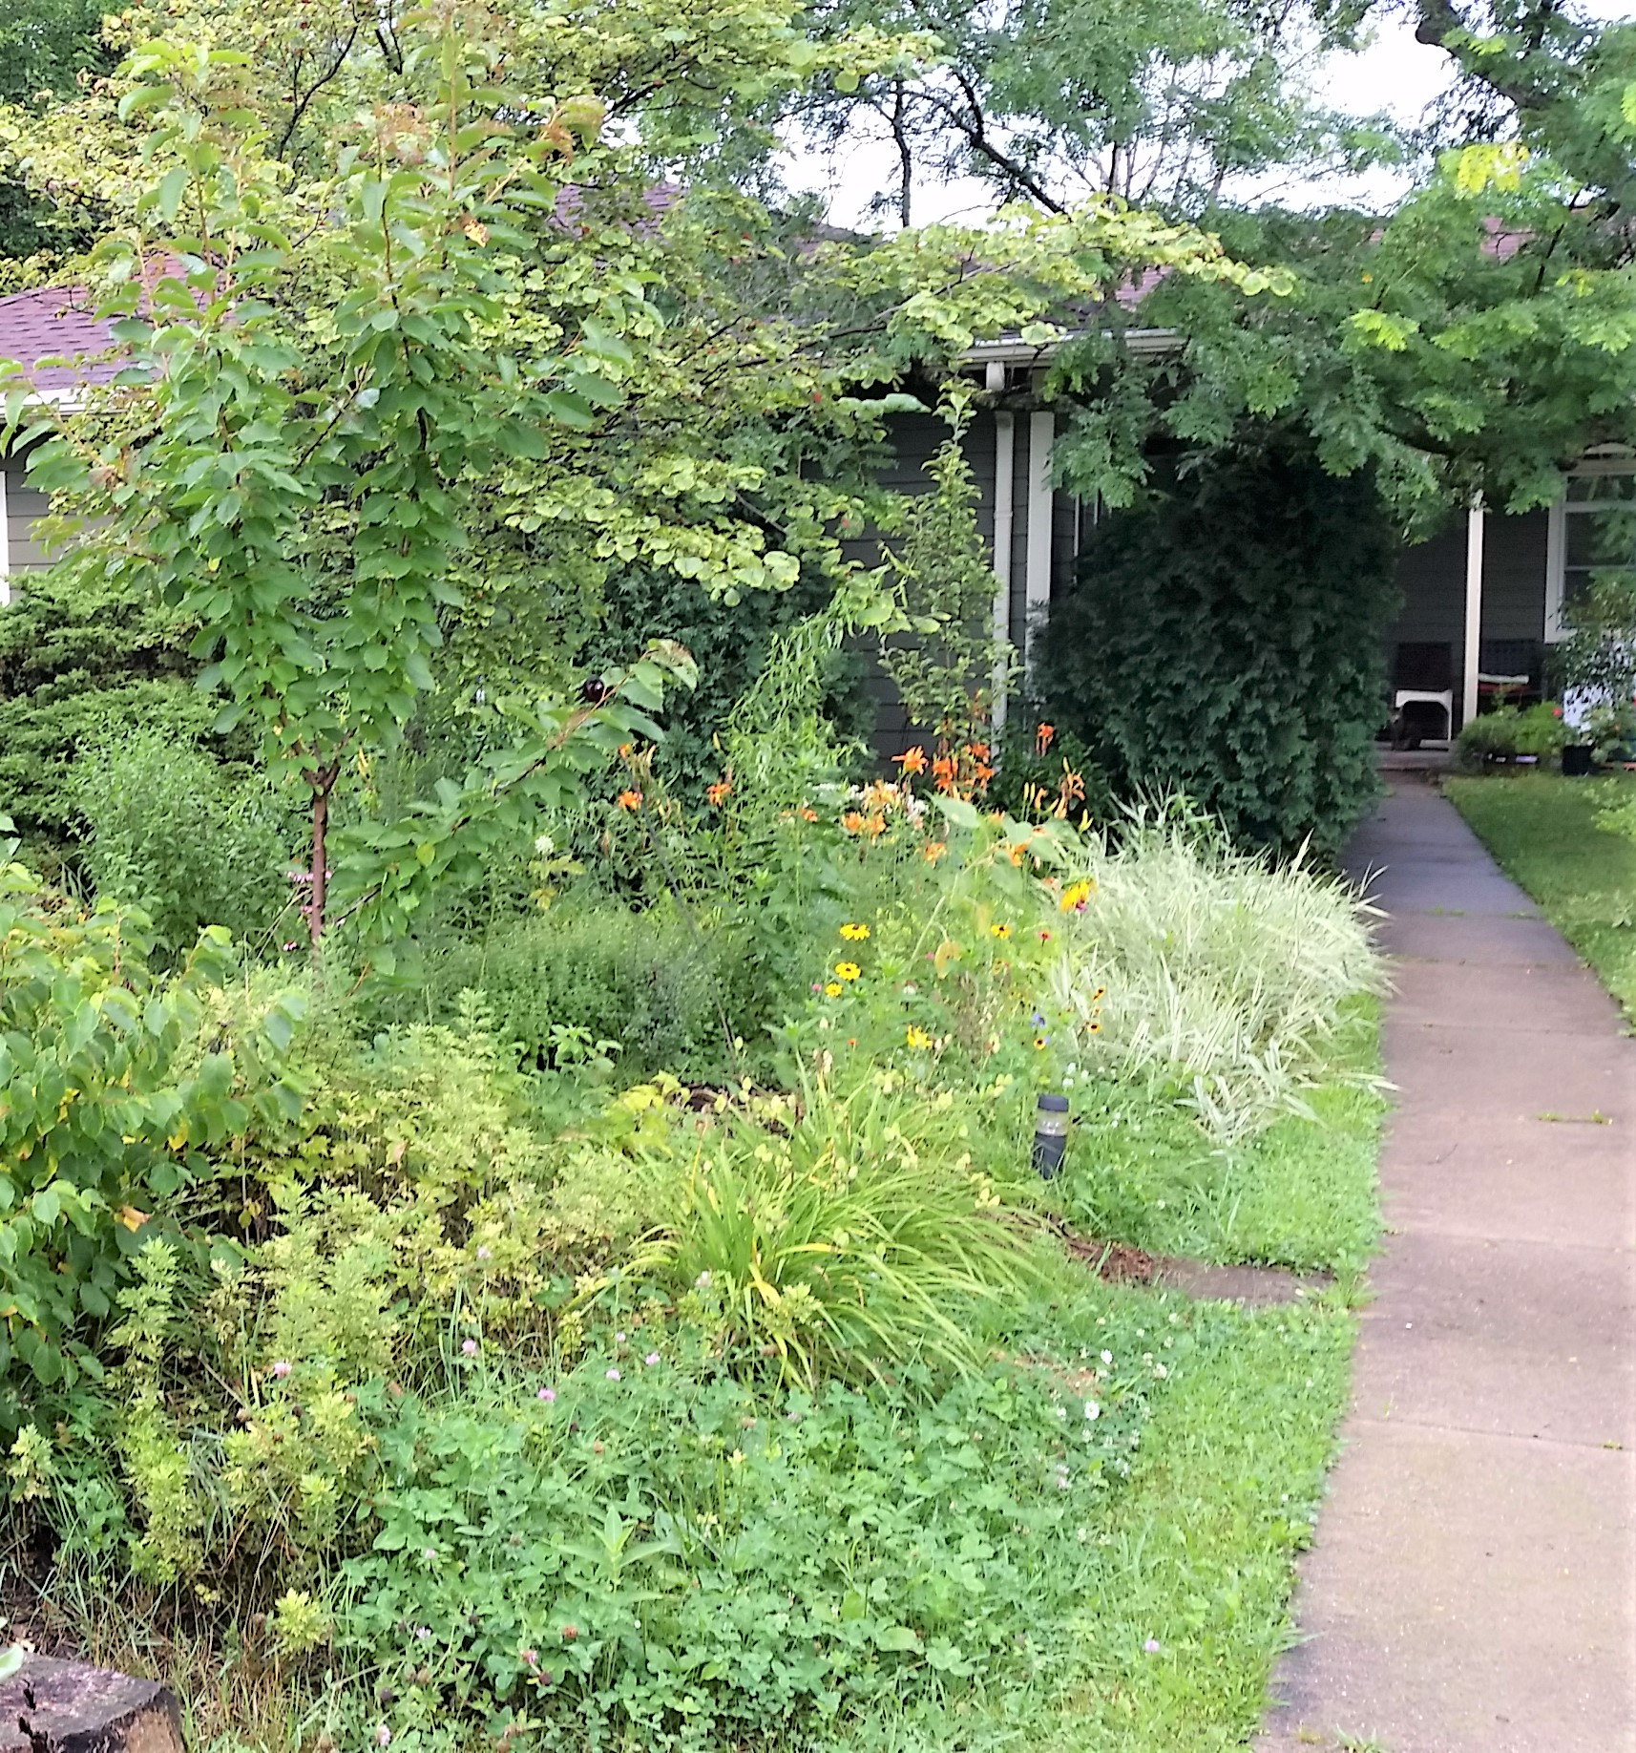
Cherry Tree Guild
With:
hazelnut, chives, raspberry, lemon balm, wormwood and other ground covers.
Rain Garden #1
Rain Garden #2
Spring 2008 June 2017

Slide 17
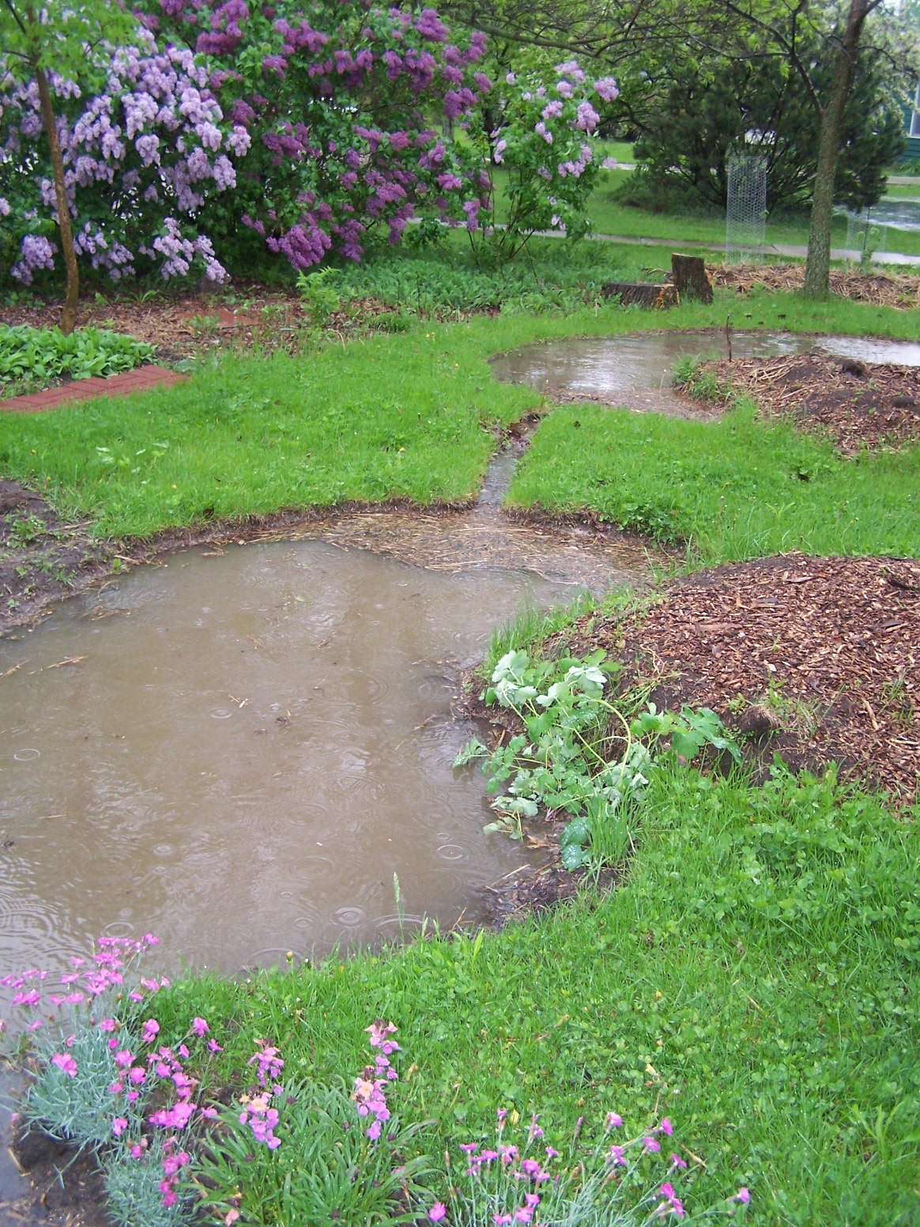
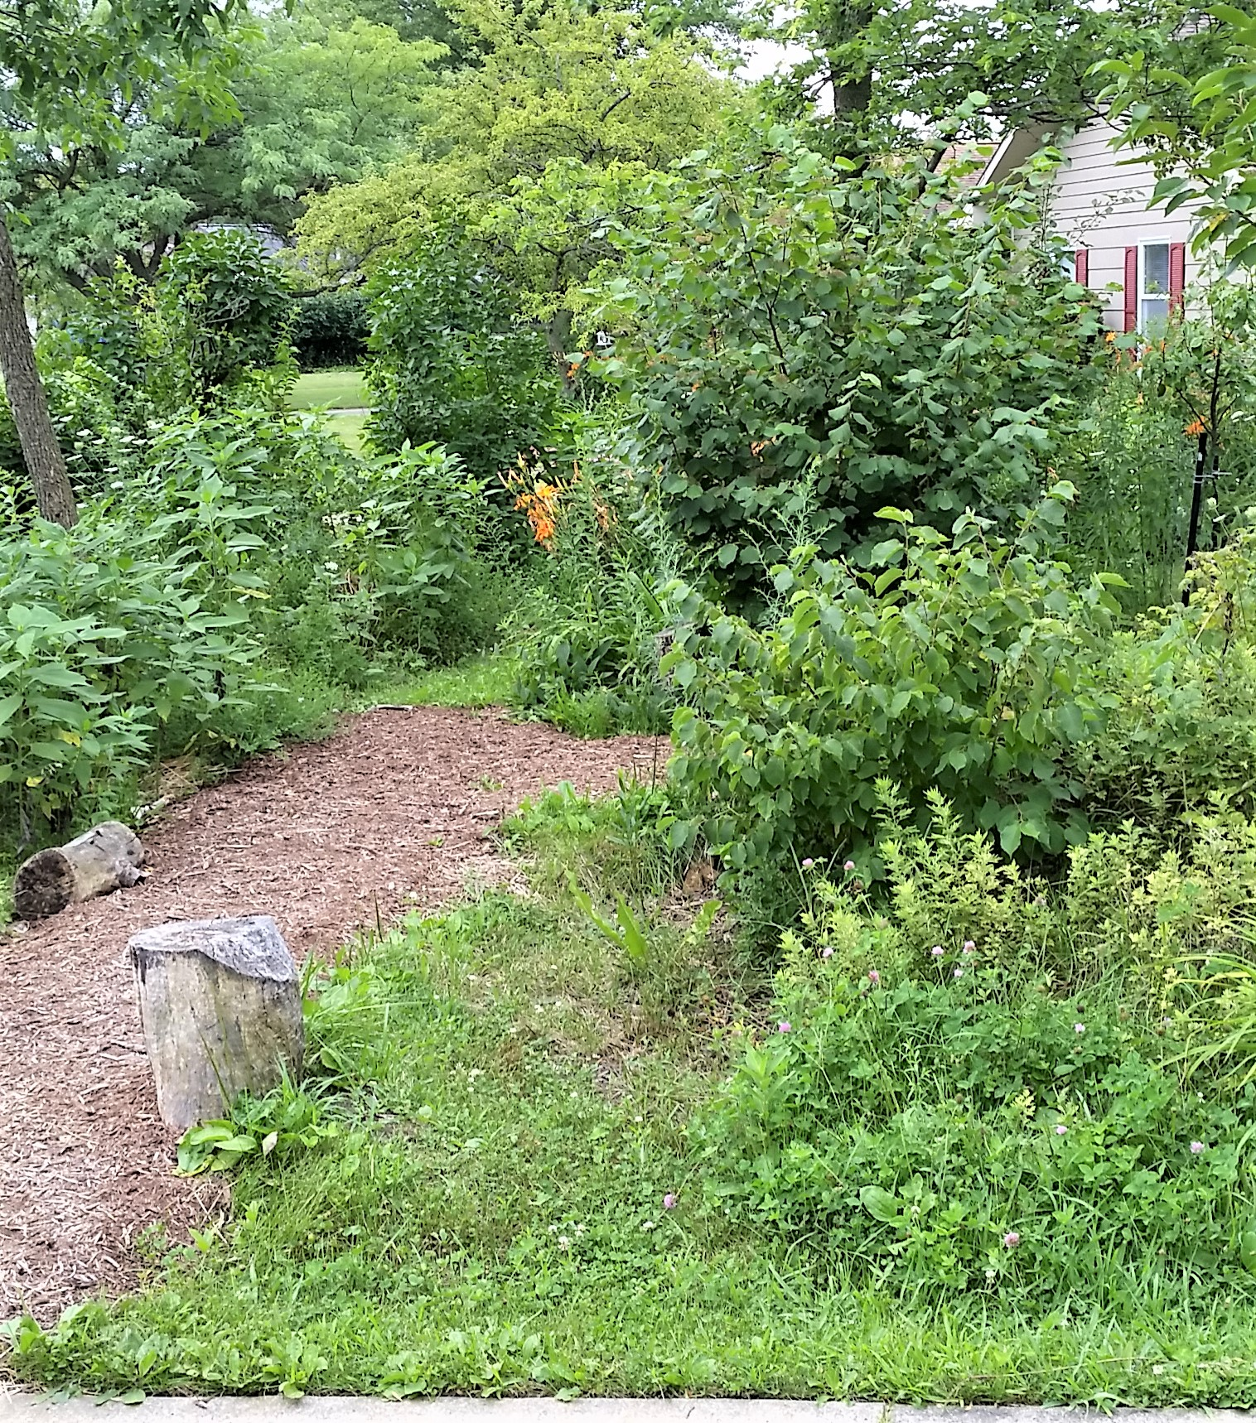
Rain Garden #3 is dense with daylilies and comfrey
Rain Garden #3
Rain Garden #2
Rain Garden #2 is basically a ground-cover bowl
2007 2017

Slide 18
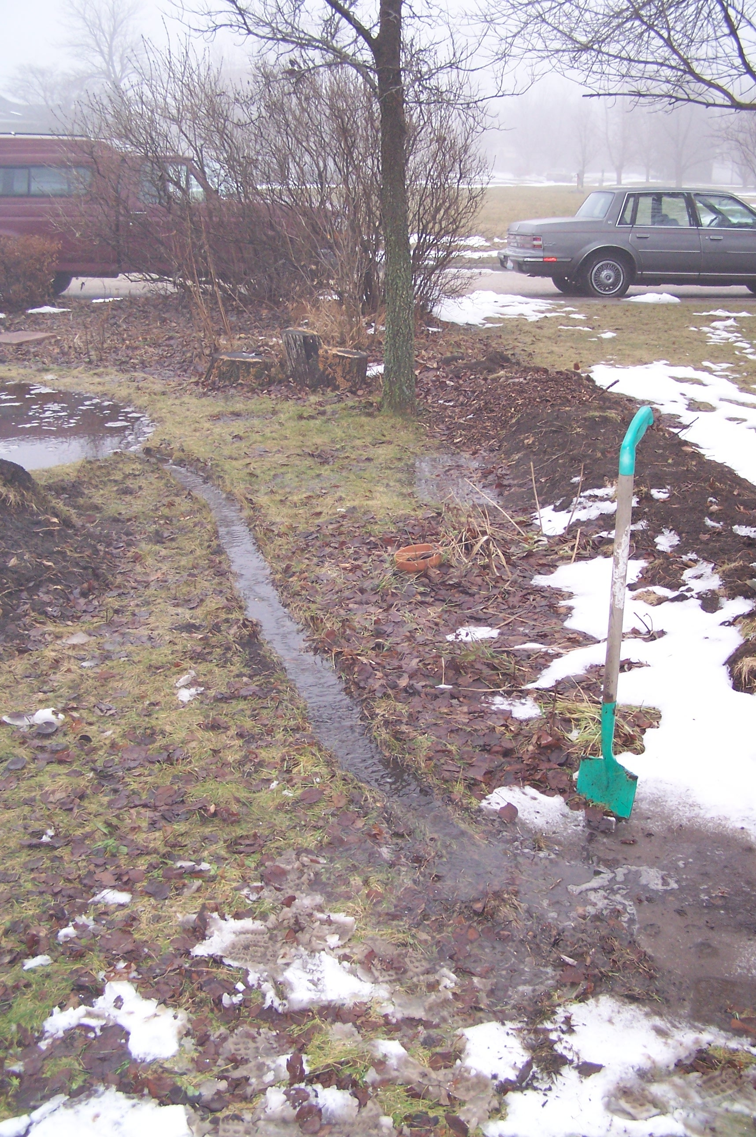
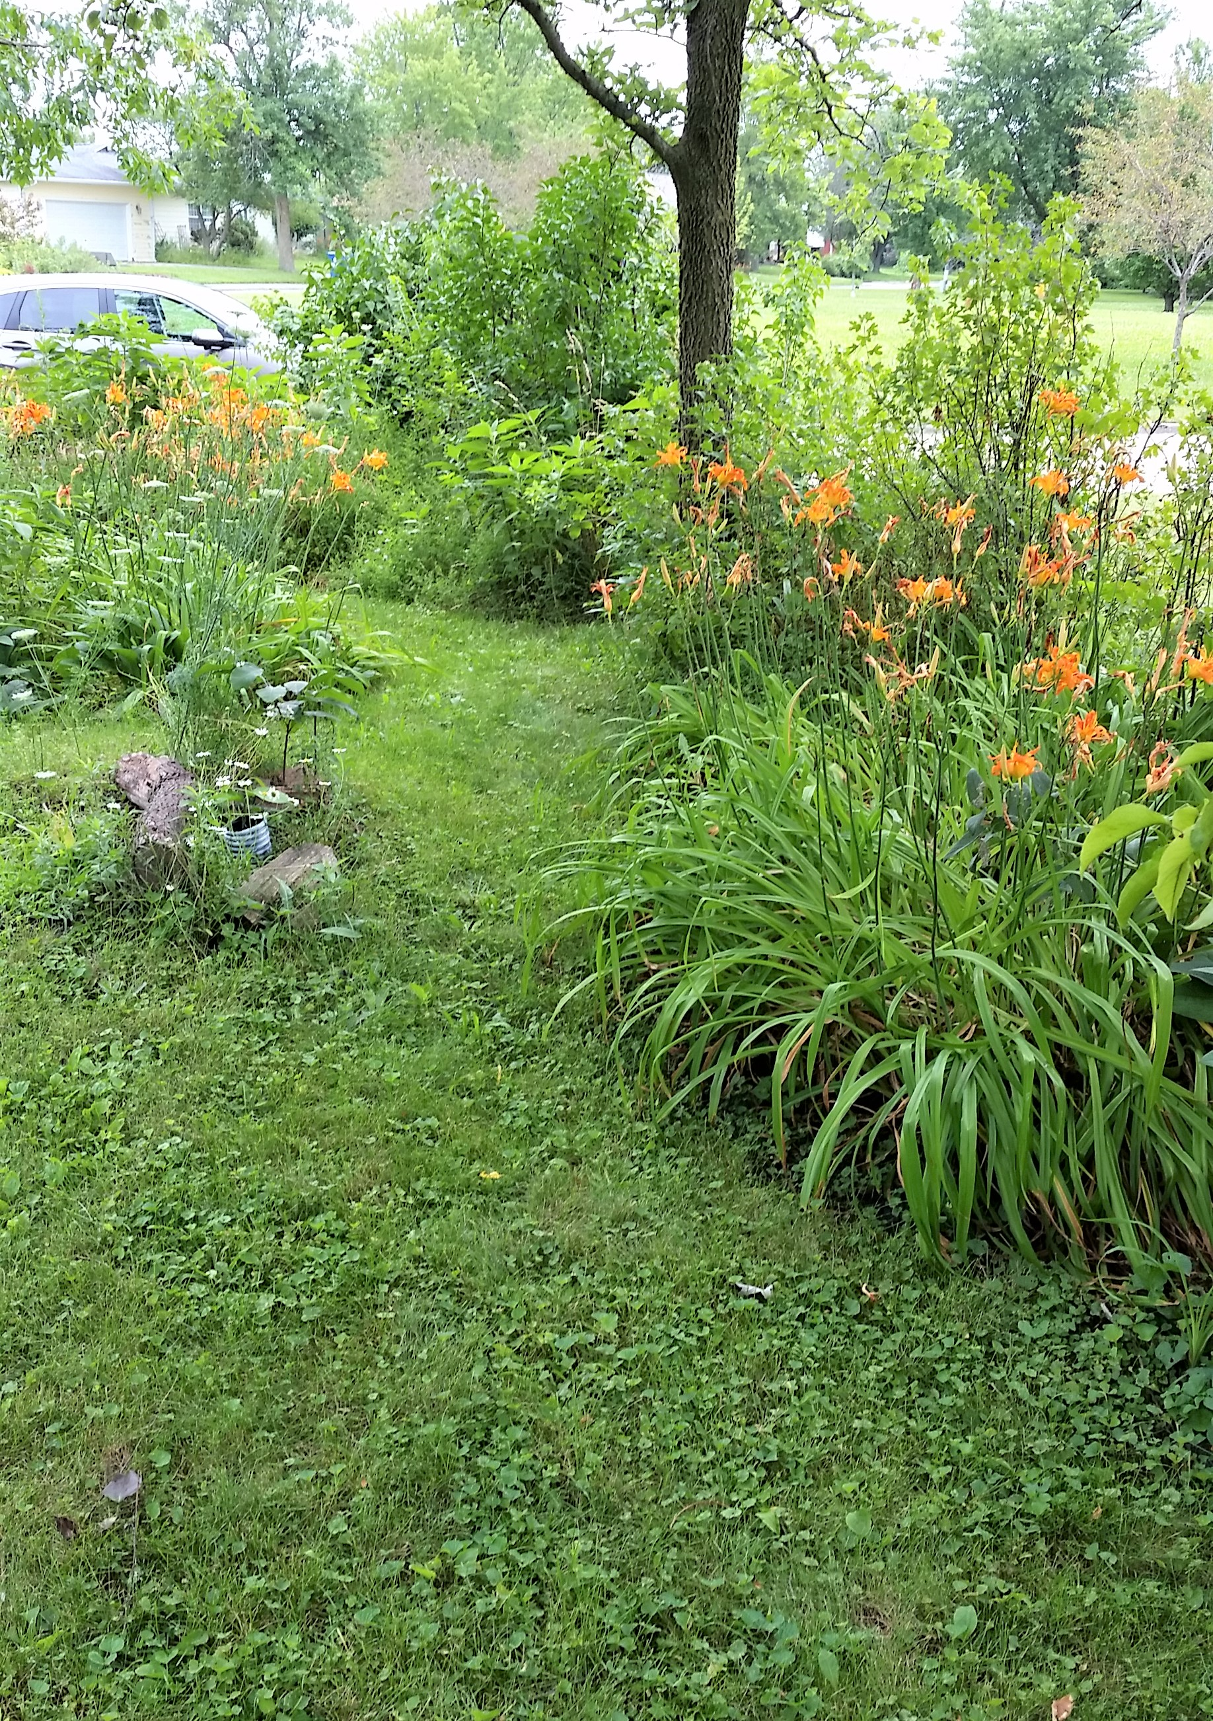
Rain Garden #3
Gooseberry and Currant Berm
2007 2017

Slide 19
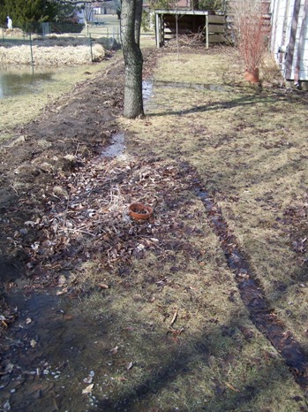
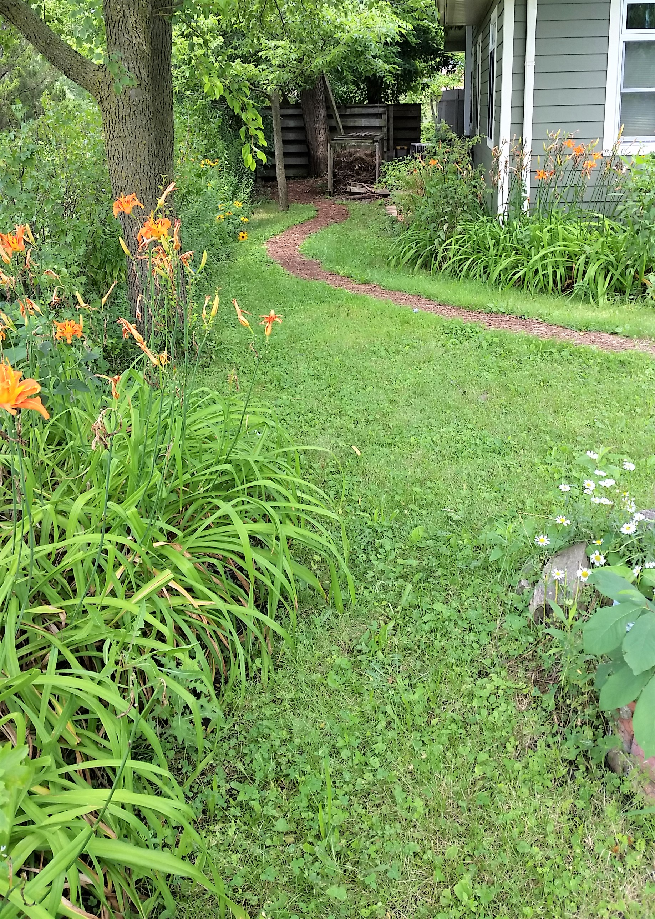
Gooseberry and Currant Hedge
Gooseberry and Currant Berm on Property Line
Edible Daylilies
Young Pawpaw
2007 2017

Slide 20
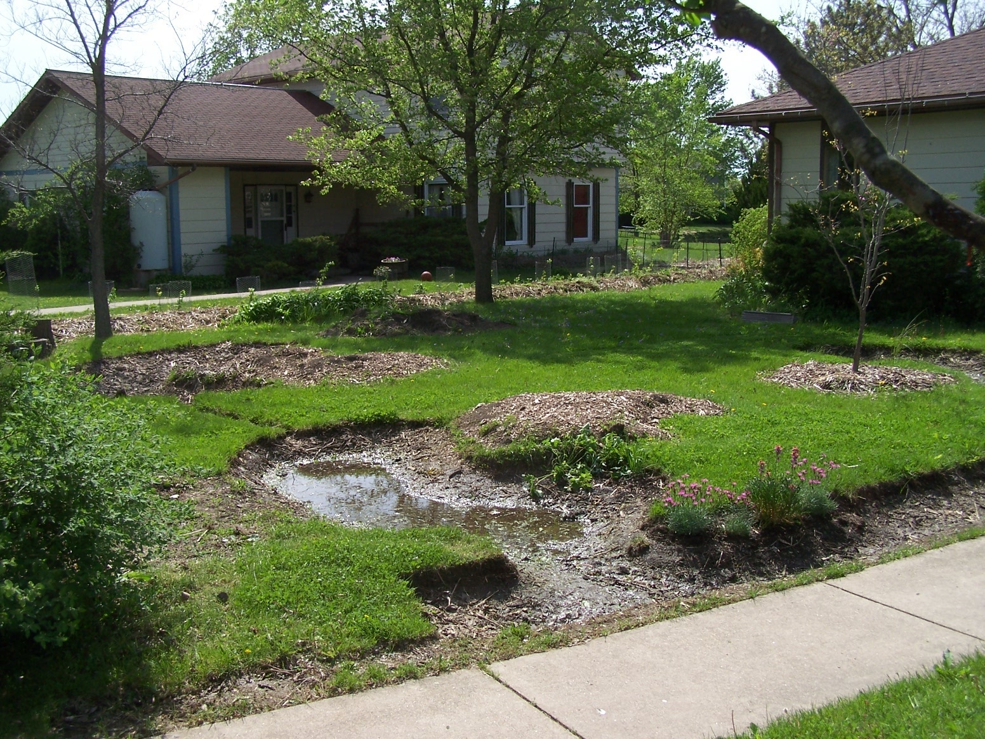
2-days Later, Rain Gardens are Still Wet

Slide 21
4-days Later, Rain Gardens are Dry
The Point Is… we don’t plant water-loving species in the rain gardens as there are times when the gardens are very dry too, especially in mid-summer. We plant water/drought tolerant species to handle wet and dry conditions. Plants that are doing well… daylilies, comfrey, curly willow, Jerusalem artichoke, and prairie plants.

Slide 22
Side and Backyard Rain-Garden Design
N

Slide 23
Before
Side and Backyard Rain-Garden Design

Slide 24
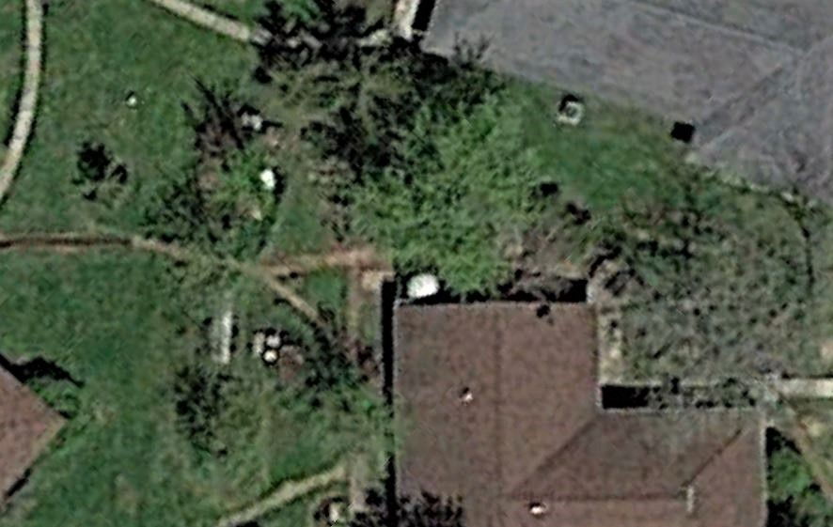
After
Garden Shed
Hugelkulturs
2 Berms
Compost Bin
425 Gal. Rainwater Tank
Aquaponics System
N
Raised Bed
Side and Backyard Rain-Garden Design

Slide 25
After
Garden Shed
Hugelkultur
Berm
Hugelkultur
Hugelkultur
Water Tank
Aquaponics
Berm
Compost
Raised Bed
Side and Backyard Rain-Garden Design
Feeder Swale

Slide 26
After
Garden Shed
Hugelkultur
Berm
Hugelkultur
When the entire system fills, the water backs-up behind the large berm….
Hugelkultur
Water Tank
Aquaponics
Berm
Berm
Compost
Raised Bed
Side and Backyard Rain-Garden Design
Feeder Swale

Slide 27
After
Garden Shed
Hugelkultur
Berm
Hugelkultur
When the entire system fills, the water backs-up behind the large berm….
Hugelkultur
Water Tank
Aquaponics
Berm
…and water now backs up into the feeder swale...
Berm
Compost
Raised Bed
Side and Backyard Rain-Garden Design
Feeder Swale

Slide 28
After
Garden Shed
Hugelkultur
Berm
Hugelkultur
When the entire system fills, the water backs-up behind the large berm….
Hugelkultur
Water Tank
Aquaponics
Berm
…and water now backs up into the feeder swale...
Berm
Compost
Raised Bed
Side and Backyard Rain-Garden Design
…which become an erosion-free spillway.
Feeder Swale

Slide 29
Overall Design
- Water Collection & Flow
Garden Shed
Wood Shed
Water Tank
Aquaponics
Compost
1
2
Back Deck
3

Slide 30
Overall Design
- Water Collection & Flow
Access/Paths
Garden Shed
Wood Shed
Water Tank
Aquaponics
Compost
1
2
Back Deck
3

Slide 31
Overall Design
- Water Collection & Flow
Access/Paths
Beds
Garden Shed
Veggie Arbor
Currants/Raspberry
Wood Shed
Water Tank
Blueberry
Vegetable Bed
Aquaponics
Aronia
Compost
Raised Bed
RG#1
RG#2
Back Deck
Herb Bed
RG#3
Grape Fence
Currants/Gooseberry/Raspberry

Slide 32
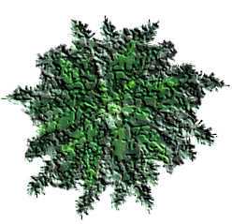
Overall Design
Understory
Raspberry
Strawberry
Kale
Chard
Walking Onions
Garlic Chives
Scallions
Horseradish
Mints
False Indigo
Borage
Clovers
Hairy Vetch
Crown Vetch
Comfrey
Echinacea
Evening Primrose
Roses for hips
Swamp Rose
Daylilies
Prairie Wildflowers
Baptisia
Compass Plant
Quinine
Milkweed
More…
- Water Collection & Flow
Access/Paths
Beds & Key Plants
Garden Shed
Veggie Arbor
Currants/Raspberry
Wood Shed
Nanking Cherry
Peach
Water Tank
Blueberry
Vegetable Bed
Aquaponics
Hazel
Aronia
Peach
Compost
Apple
Apple
Cherry
Raised Bed
Peach
Elderberry
Peach
RG#1
Cherry
RG#2
Hazel
Back Deck
Herb Bed
Elderberry
Hazel
Peach
Pear
RG#3
Wild Plum
Grape Fence
Currants/Gooseberry/Raspberry

Slide 33
x
Overall Design
Understory
Raspberry
Strawberry
Kale
Chard
Walking Onions
Garlic Chives
Scallions
Horseradish
Mints
False Indigo
Borage
Clovers
Hairy Vetch
Crown Vetch
Comfrey
Echinacea
Evening Primrose
Roses for hips
Swamp Rose
Daylilies
Prairie Wildflowers
Baptisia
Compass Plant
Quinine
Milkweed
More…
x
N
- Water Collection & Flow
Access/Paths
Guilds-Beds-Planted Areas
Existing Trees & Shrubs
x
Garden Shed
x
x
Veggie Arbor
x
x
Wood Shed
Currants/Raspberry
x
x
Nanking Cherry
Peach
Water Tank
Blueberry
Vegetable Bed
Aquaponics
Hazel
Aronia
Peach
Compost
Apple
Apple
Cherry
x
Raised Bed
Peach
Elderberry
x
Peach
RG#1
x
x
Cherry
RG#2
Hazel
x
Back Deck
x
x
Herb Bed
Elderberry
Hazel
Peach
x
Pear
x
x
x
x
RG#3
x
x
x
x
x
x
x
Wild Plum
Grape Fence
Currants/Gooseberry/Raspberry
Permaculture Design by Midwest Permaculture
125 Crescent Lane, Stelle, Il 60919
815-256-2215 -- Info@MidwestPermaculture.com
www.MidwestPermaculture.com
Home of Midwest Permaculture
.25 acre
Designers: Becky and Bill Wilson
25 Feet

Slide 34
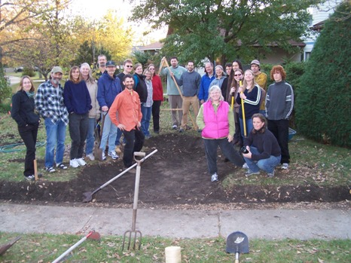

Slide 35
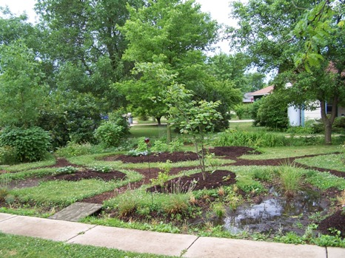

Slide 36
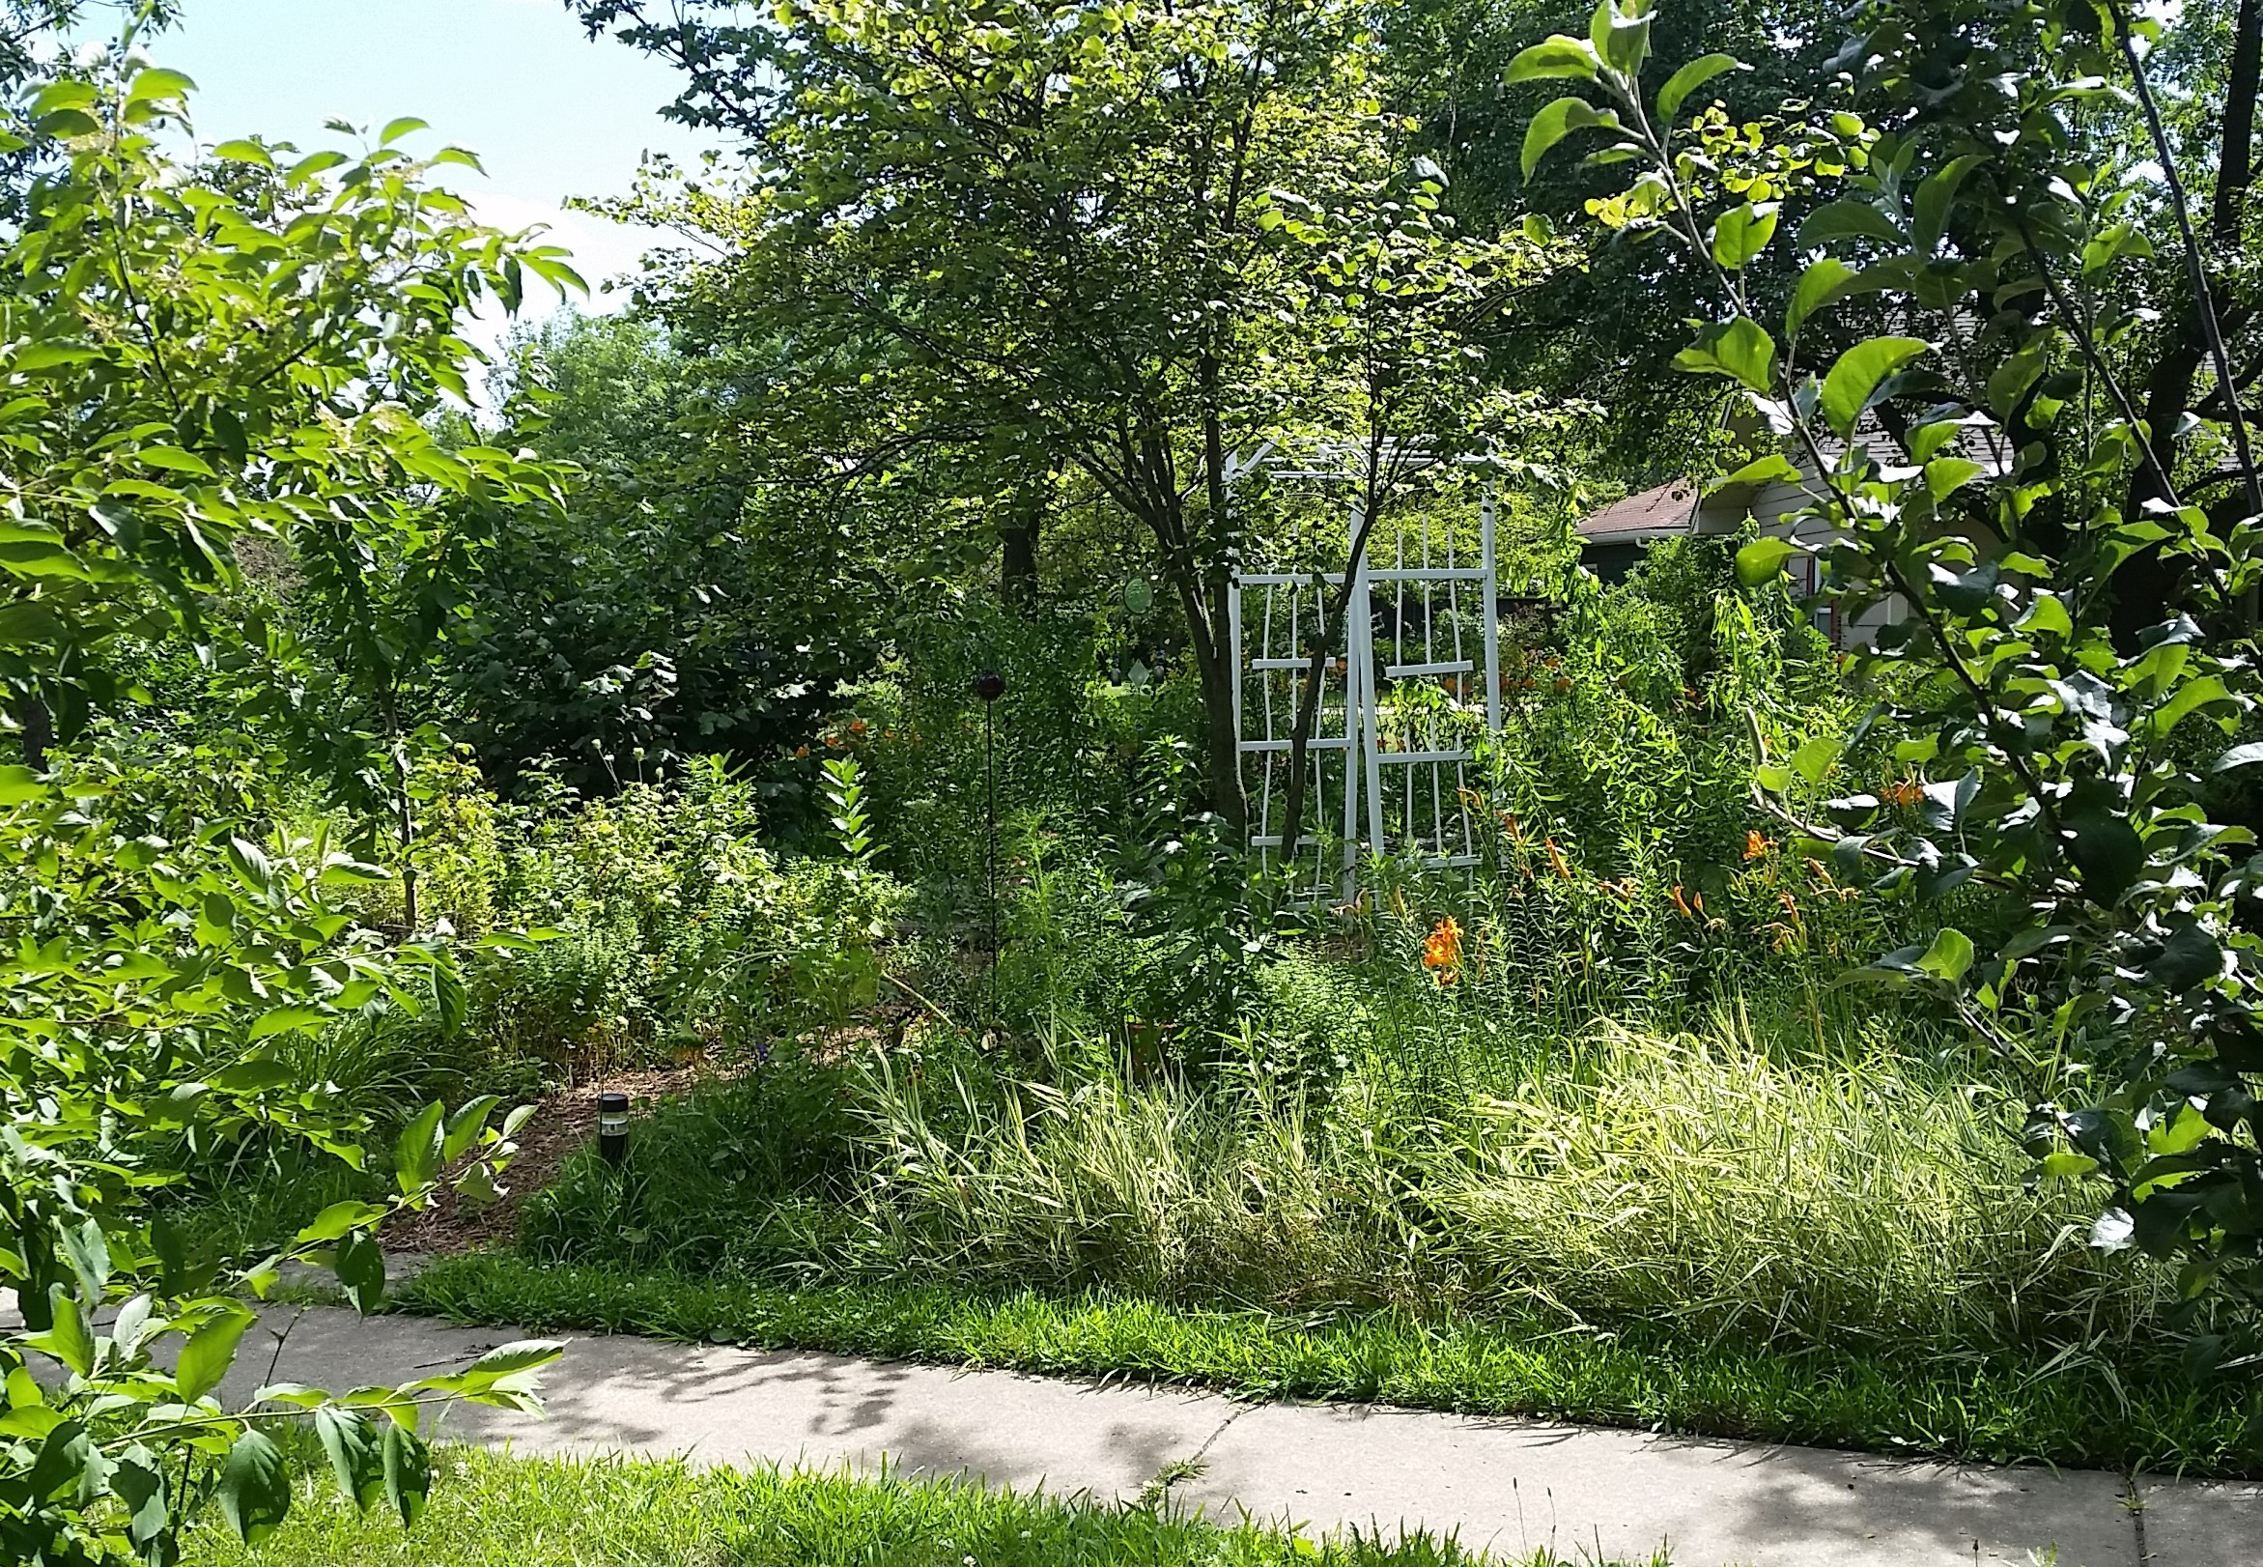

Slide 37
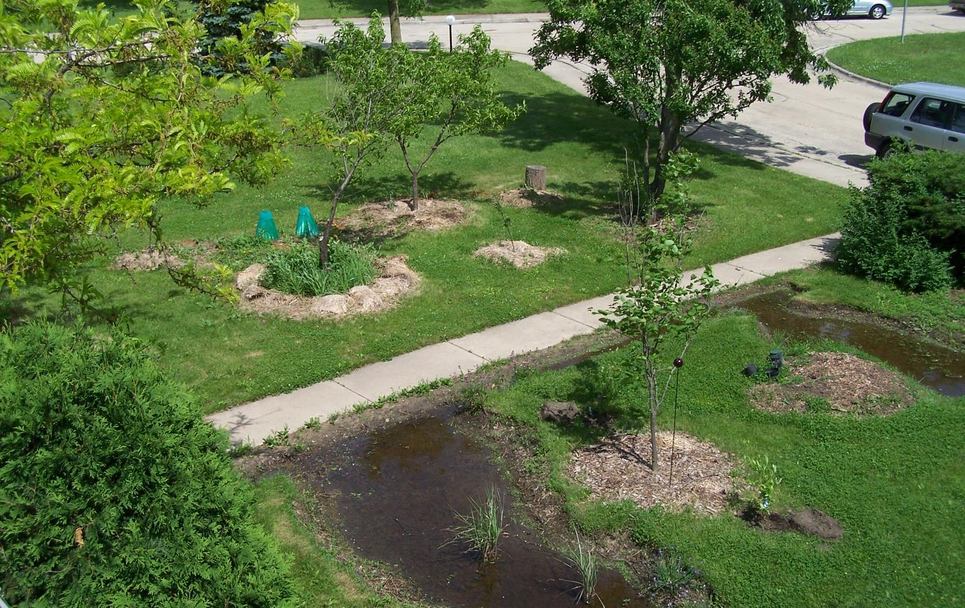

Slide 38
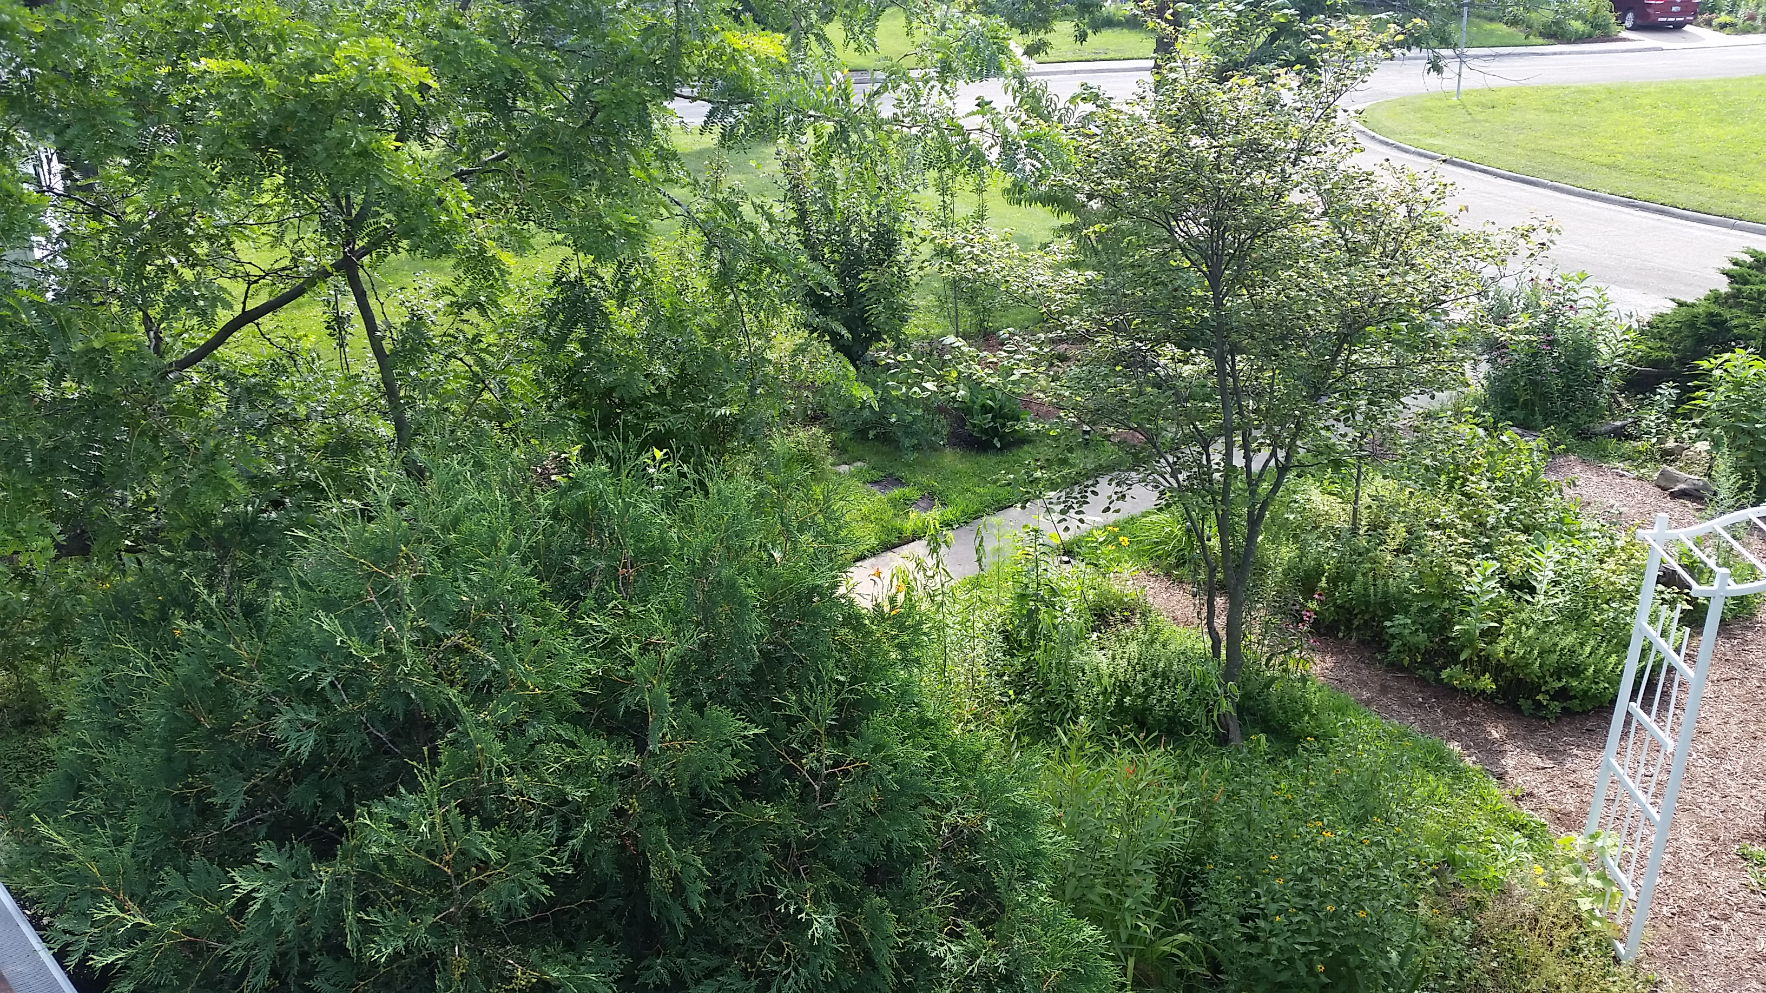

Slide 39
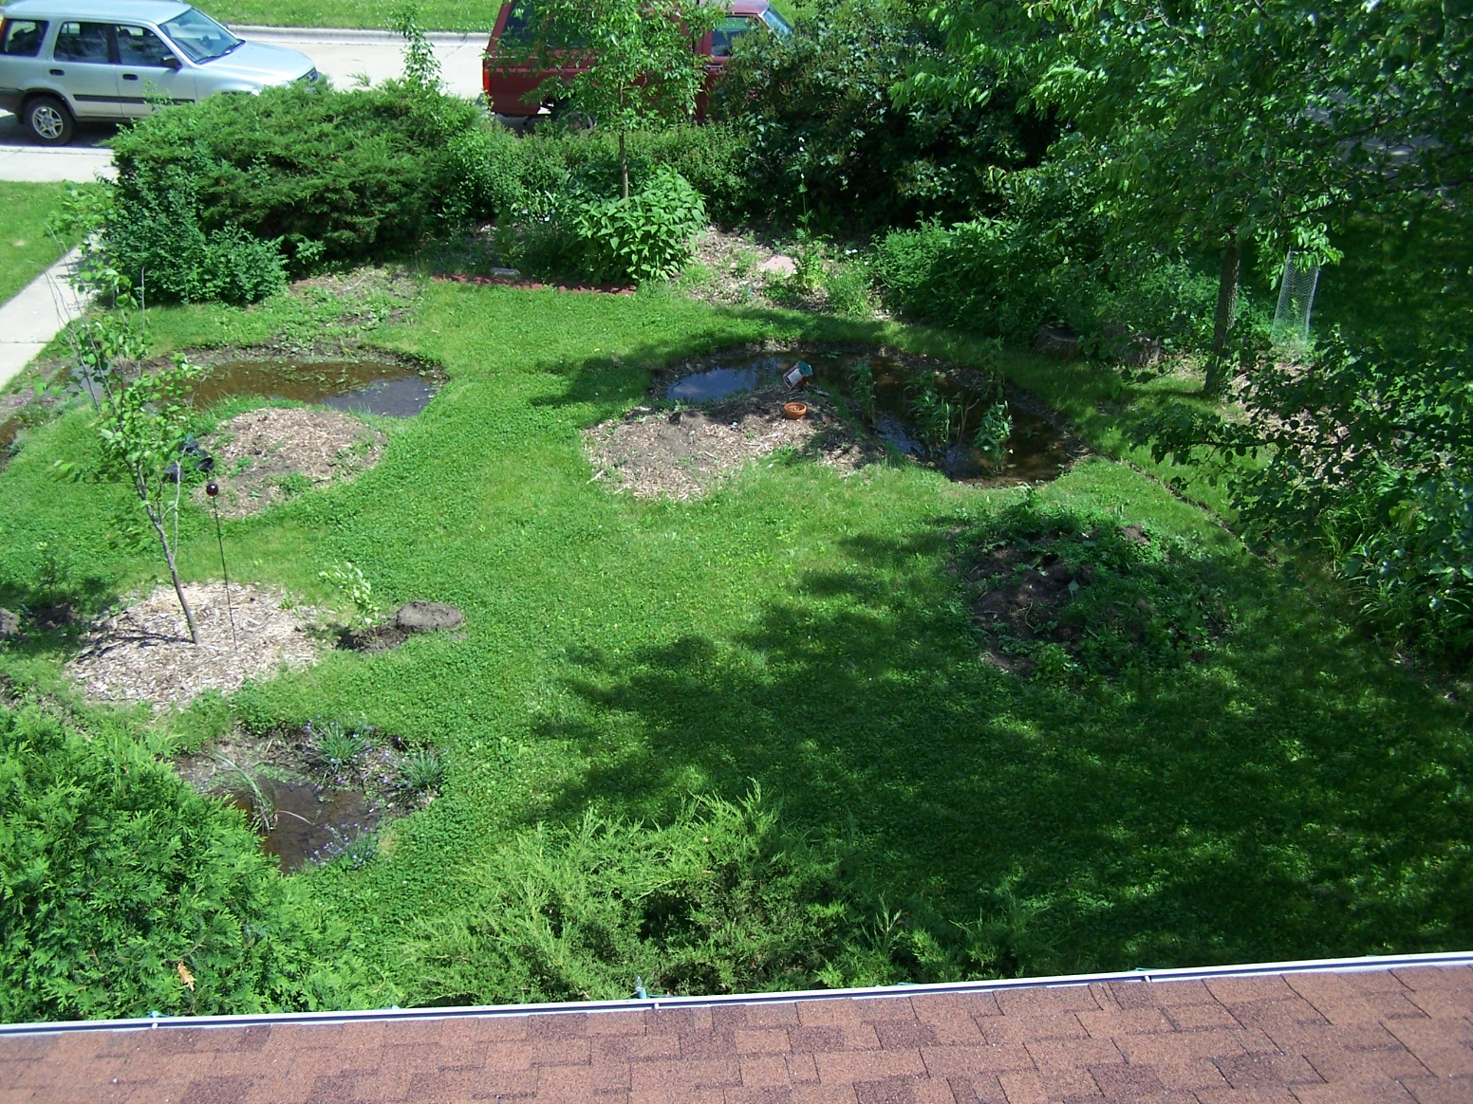
Sidewalk
Tree
2
3
1

Slide 40
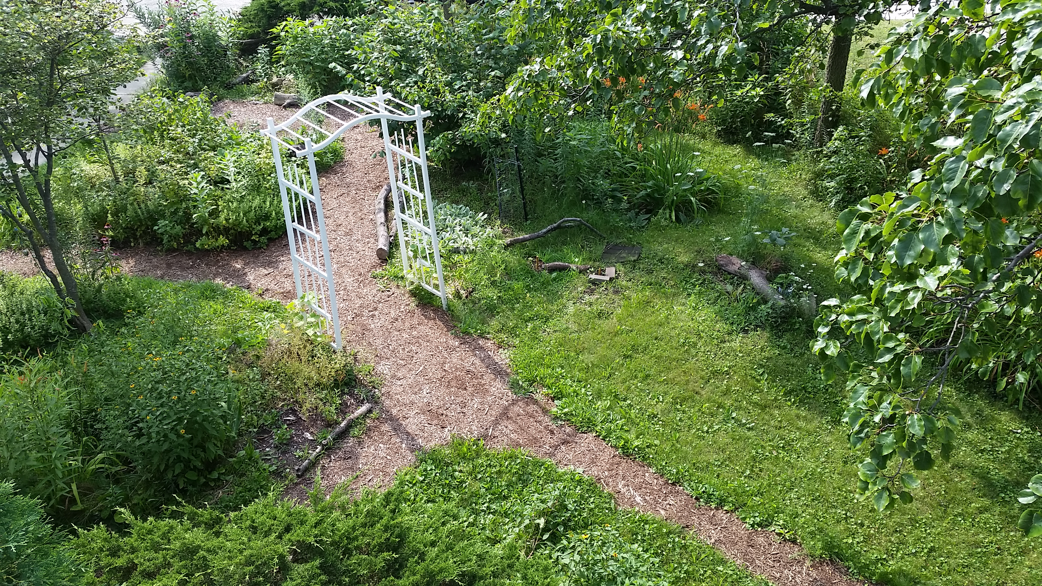
Sidewalk
Tree
2
3
1

Slide 41
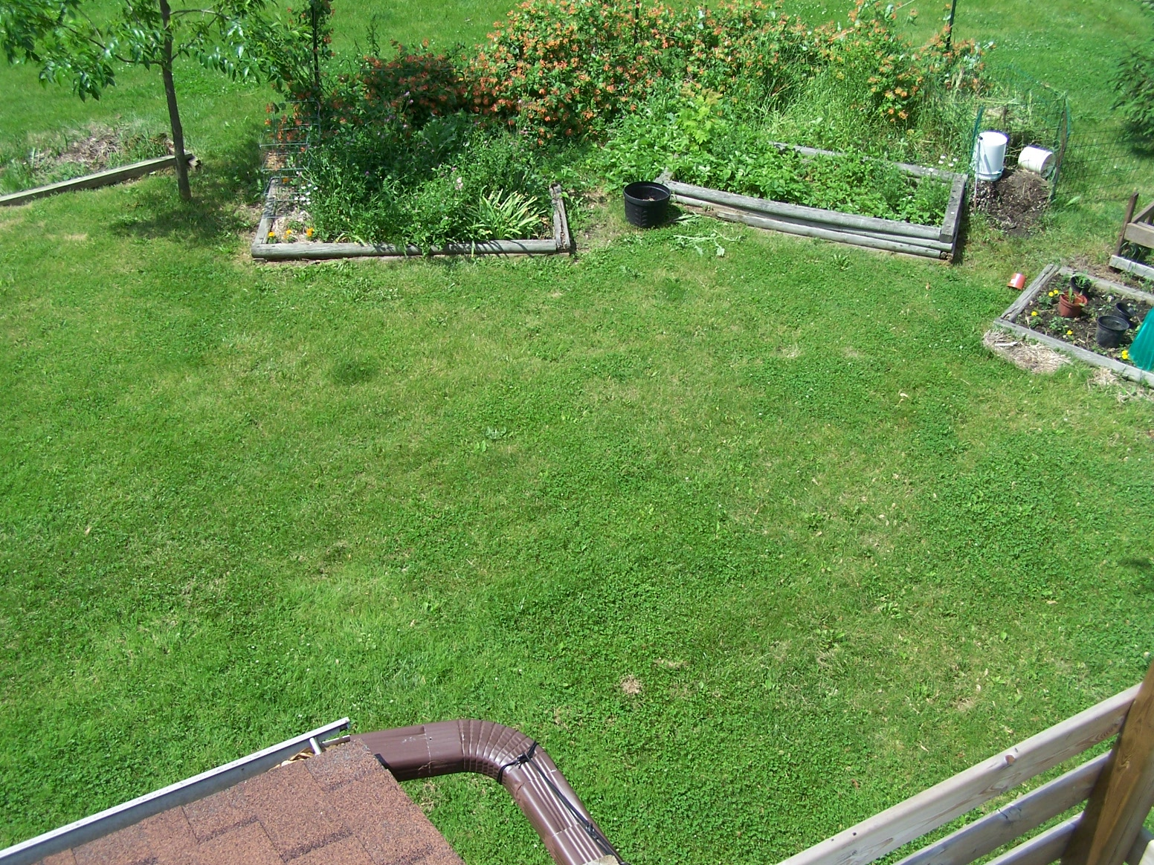
Steel Post
Tree
Gutter

Slide 42
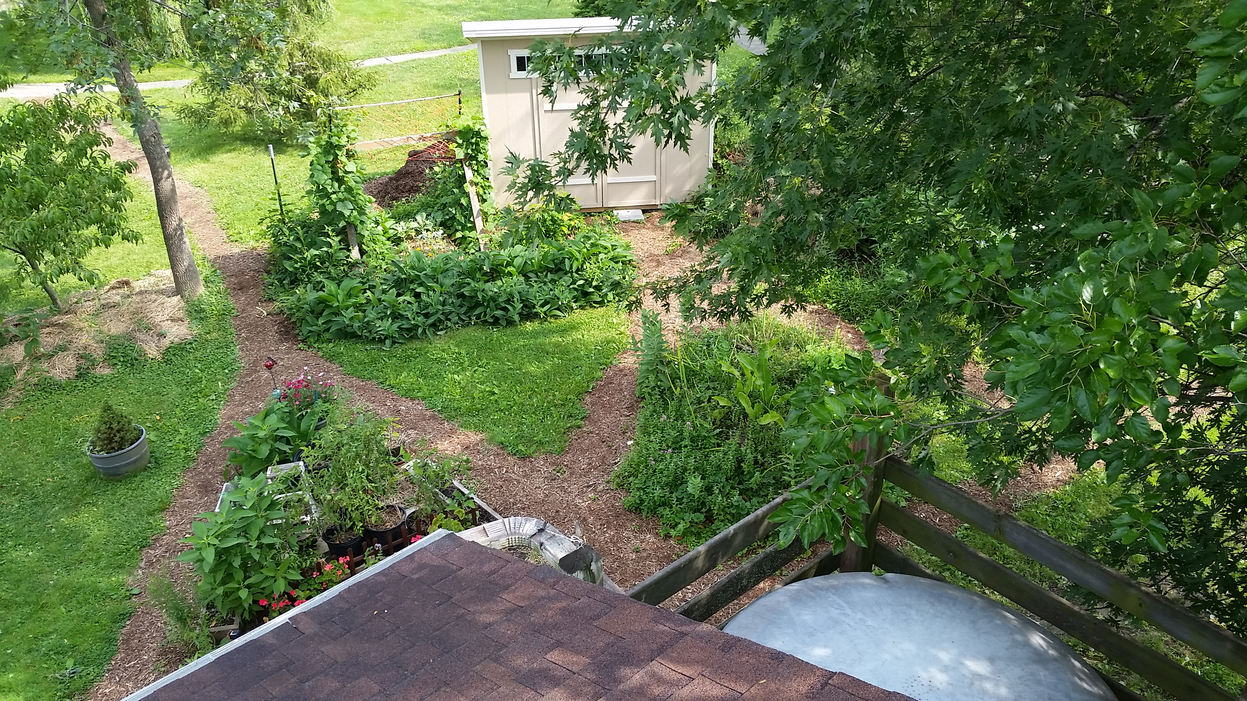
Steel Post
Tree
Gutter

Slide 43
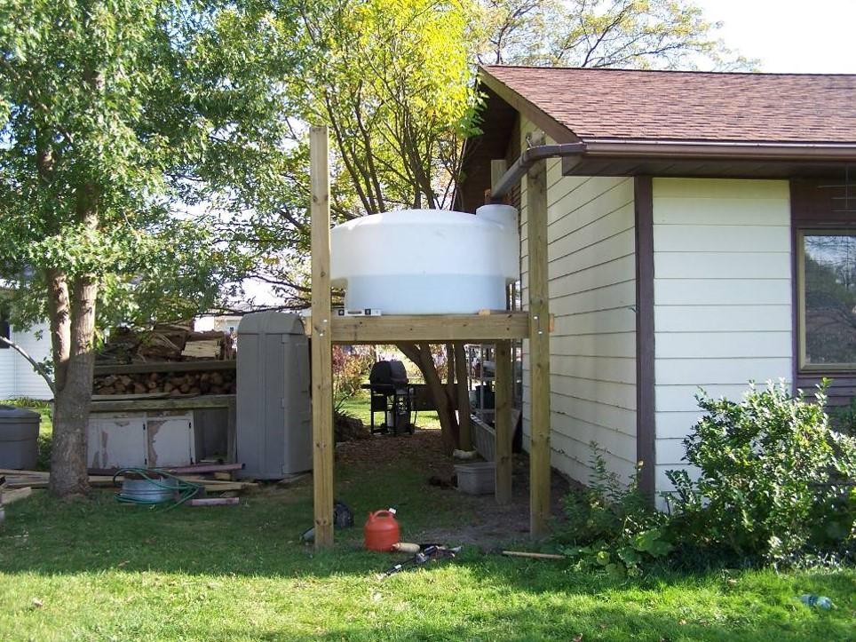
425 Gallon Pickup-Truck Tank ($250)

Slide 44
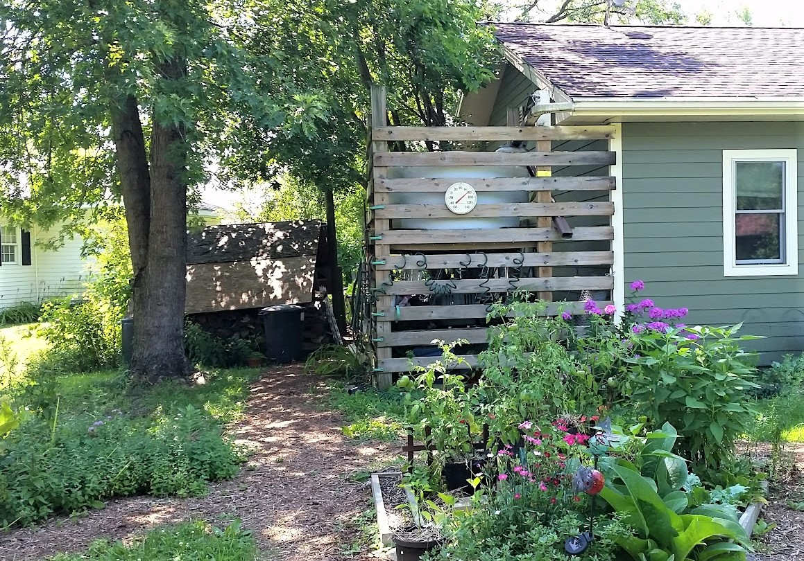
Fills up with every 1” rain
How much rain comes off of your roof?
With a 1,000 sq. ft. home 623 gallons with every 1” rain.

Slide 45
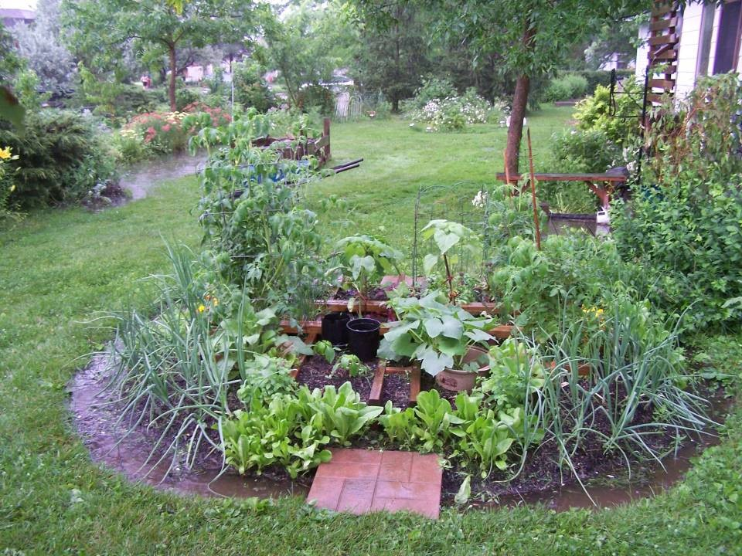
Kitchen/Herb Garden off the Back Deck
Tomato x 2
Basil x 3
Green Pepper x 2
Onion
Lettuce Marigolds
Egg plant
Squash
Cucumbers
Chives
Borage
Lemon Balm
Celery
Sunflowers
Chinese greens
Volunteer amaranth
Volunteer lambs quarter

Slide 46
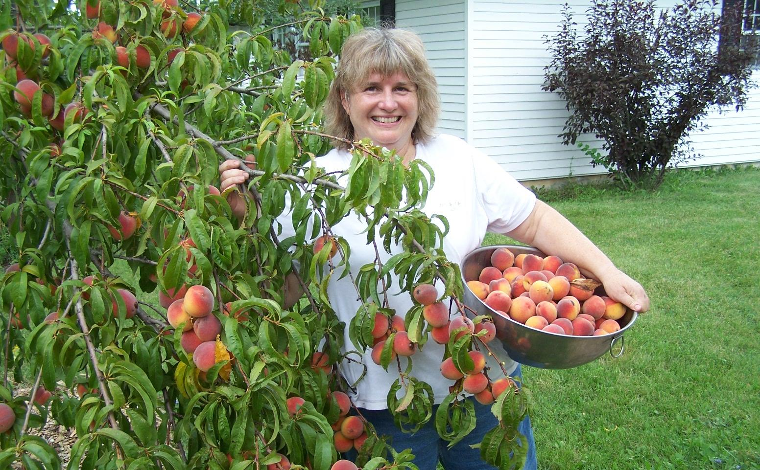

Slide 47
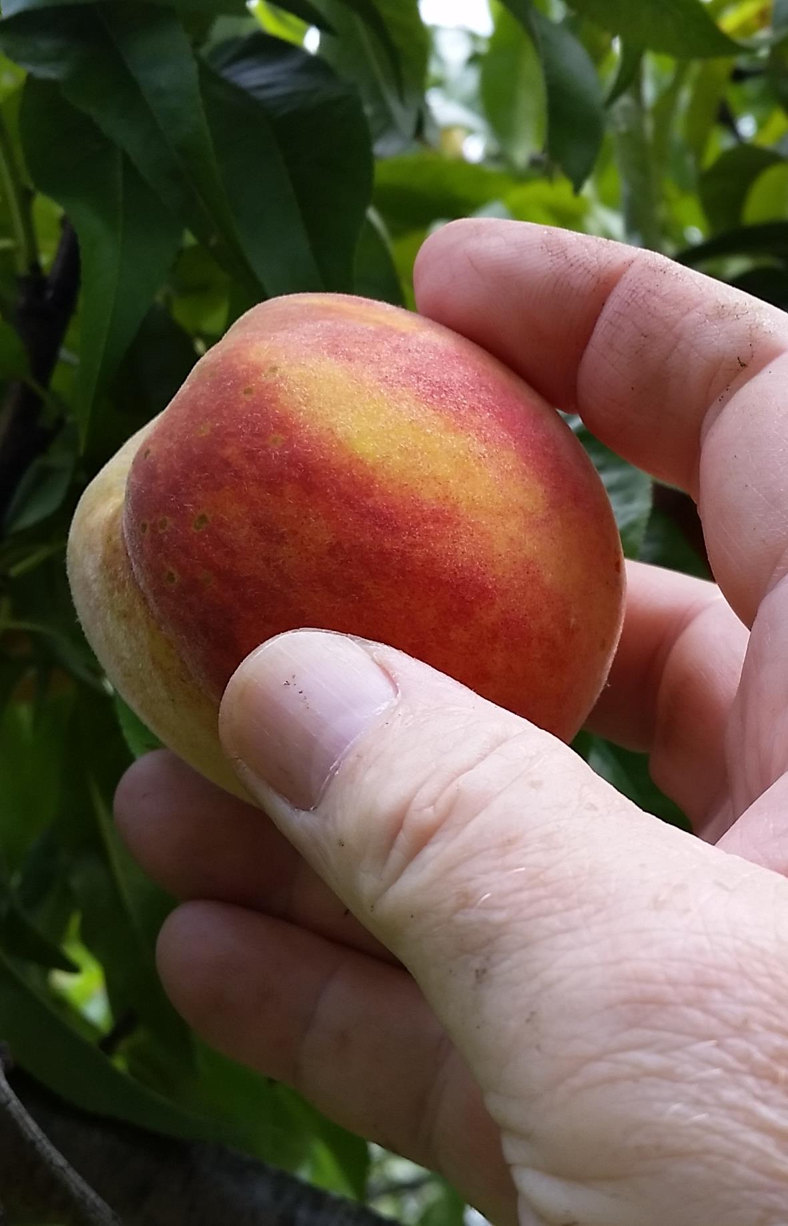
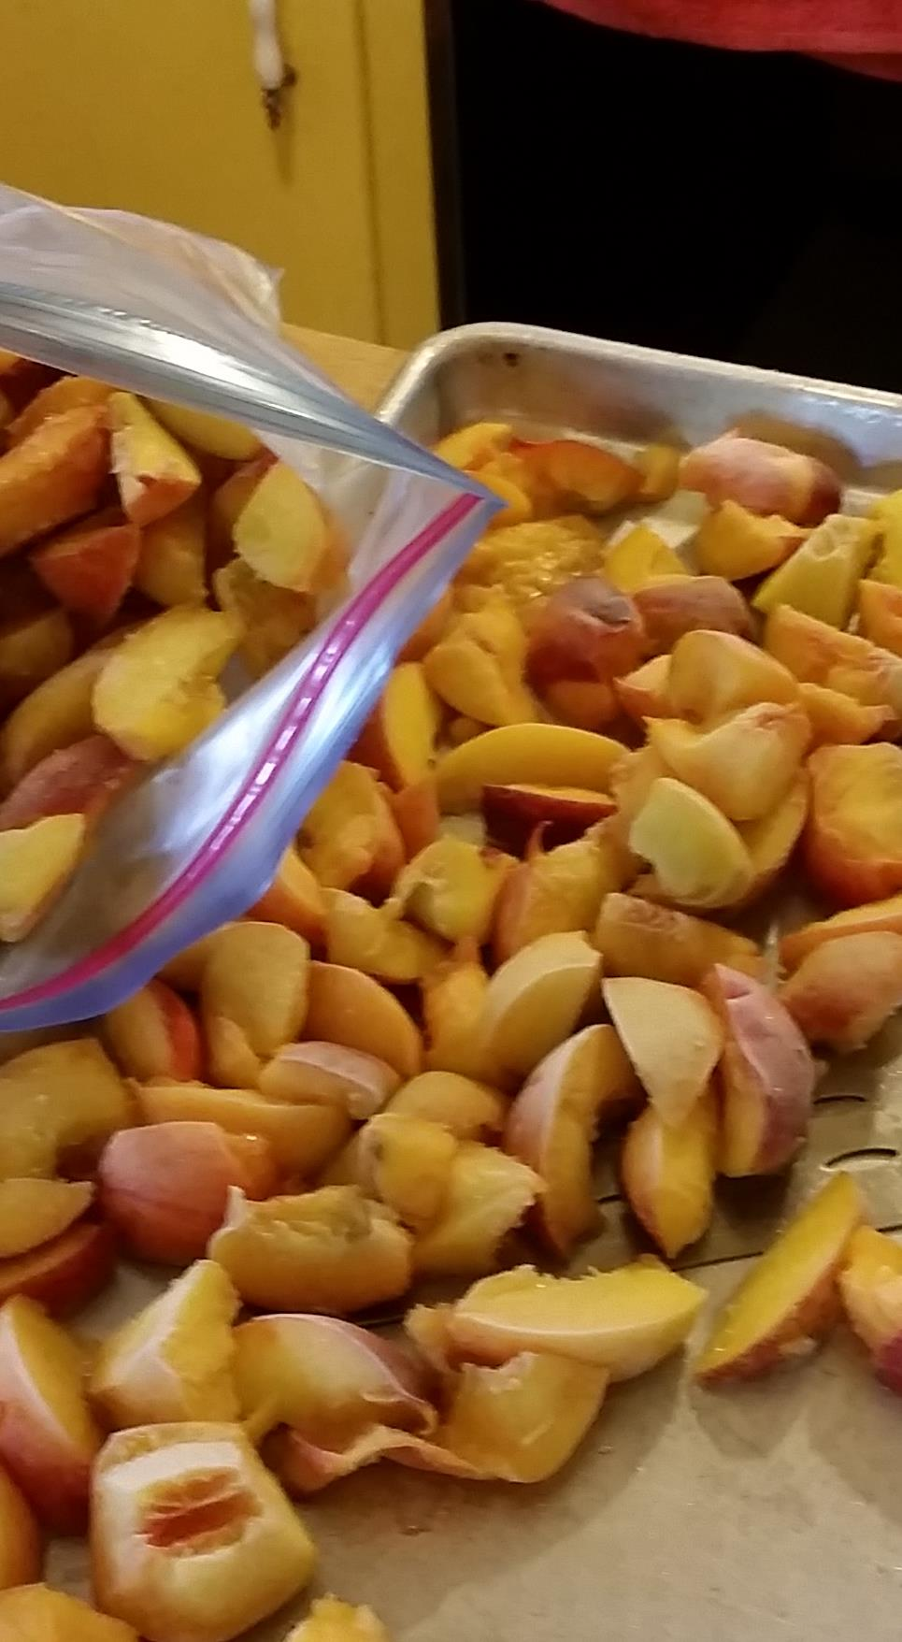
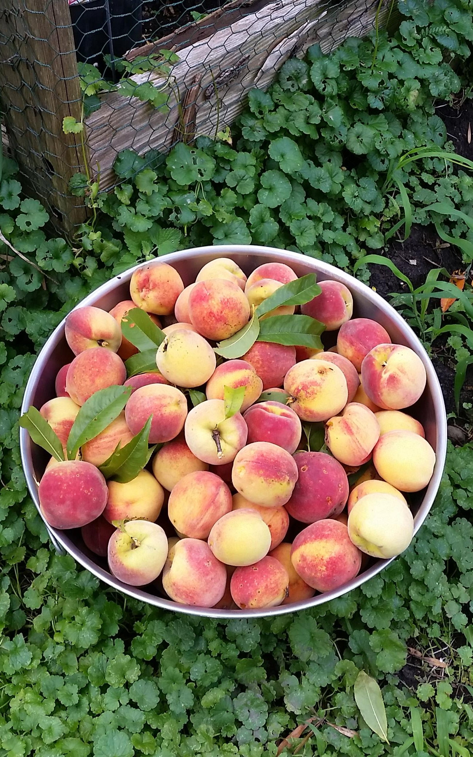
Frozen on trays then placed into freezer bags for winter smoothies and pies.

Slide 48
