Slide 1
PowerPoint Graphic Palette Midwest Permaculture Students
Here are most of the Images that I use. All are vector files so they should stay clear and sharp regardless of how large or small you make them.
Bill Wilson – Midwest Permaculture

Slide 2
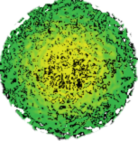
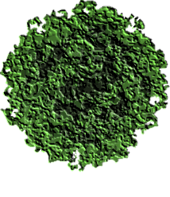
Vector Files
Just copy and paste into your designs
Solid
5
Hazel
Transparent
Siberian Pea Shrub
Flower Bed

Slide 3
0 Feet 100

Slide 4
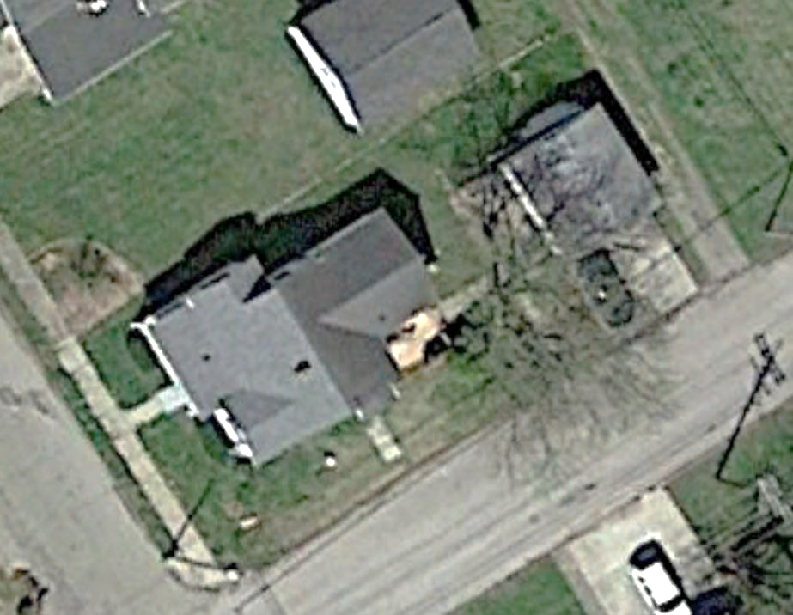
N
Annie’s Permaculture Design Services
125 Apple Ave..
Peotone, IL
Since 2016
Conceptual Design #1 10-5-21
Design for Martin Family 625 Main Street Anytown, IL
0 12 60

Slide 5
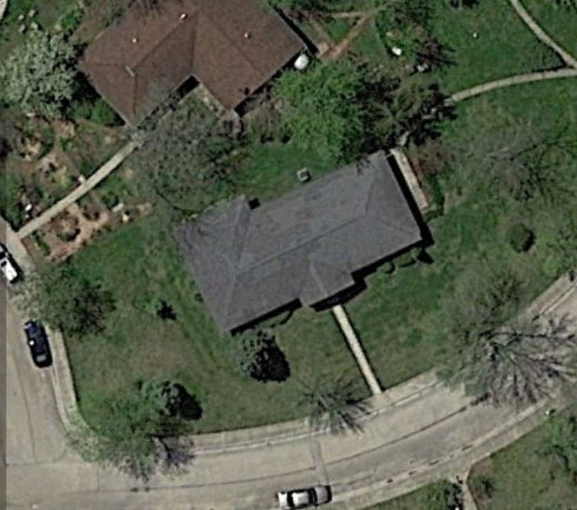
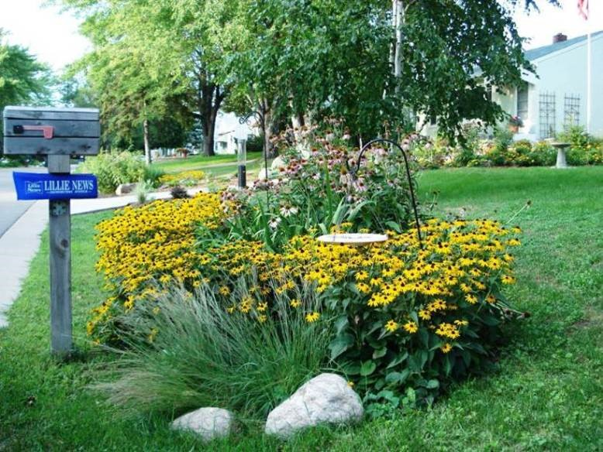
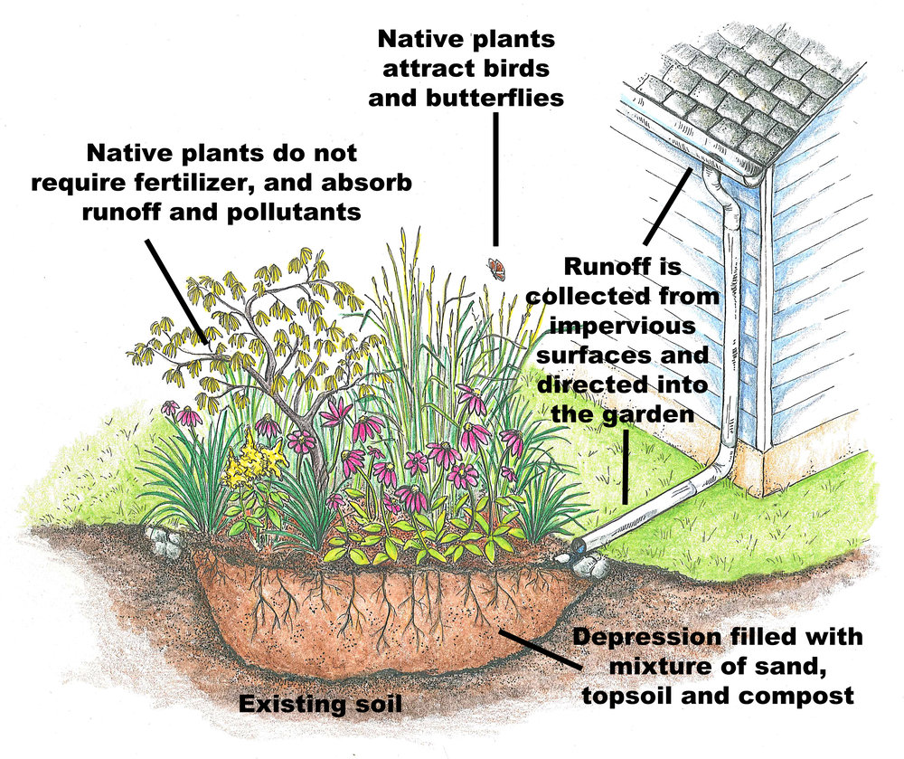
Rain Garden
Signature Block
0 Feet 50

