Slide 1
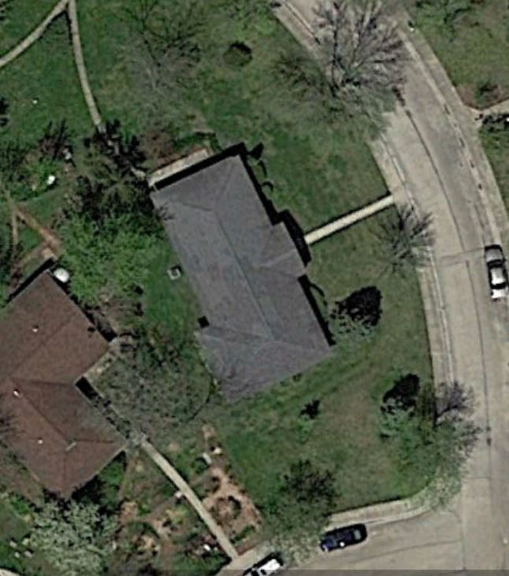
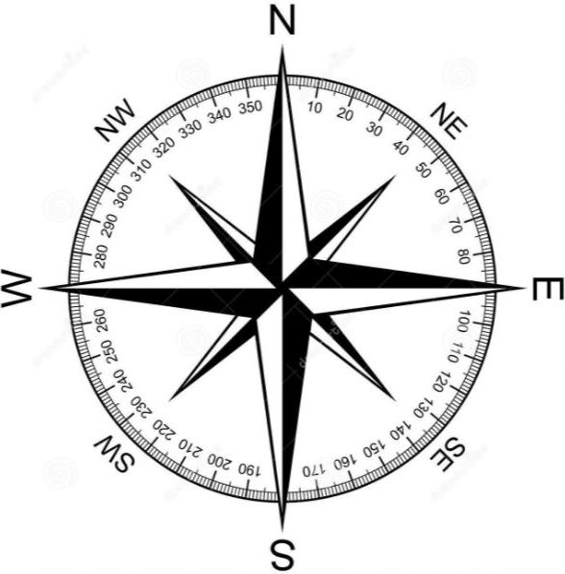
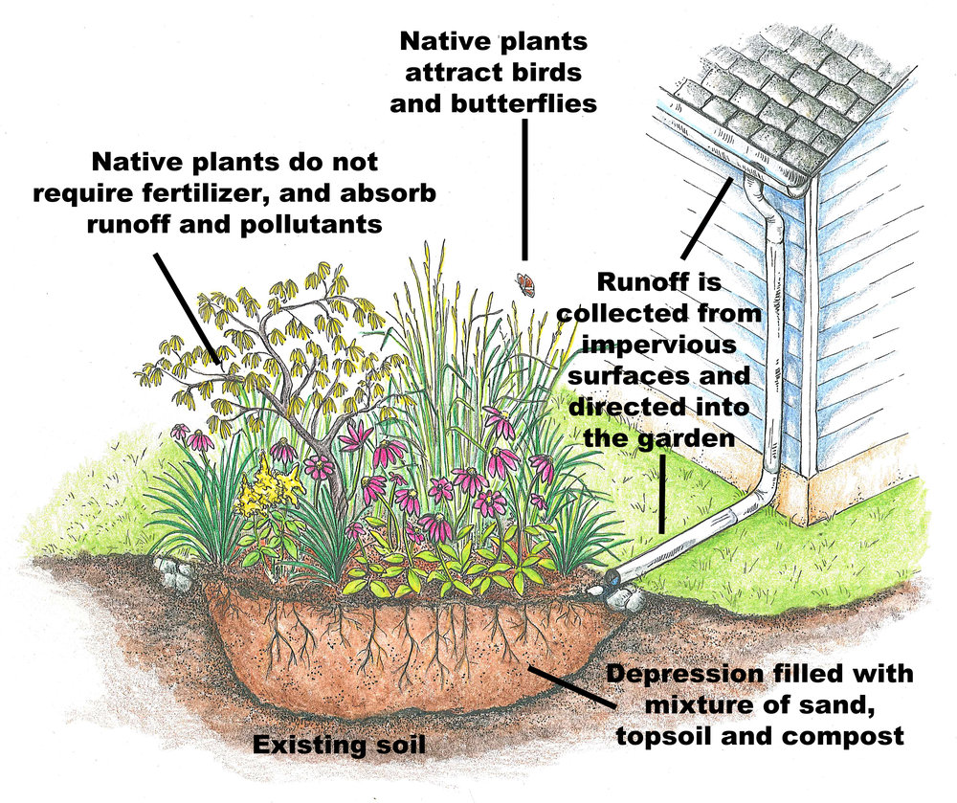
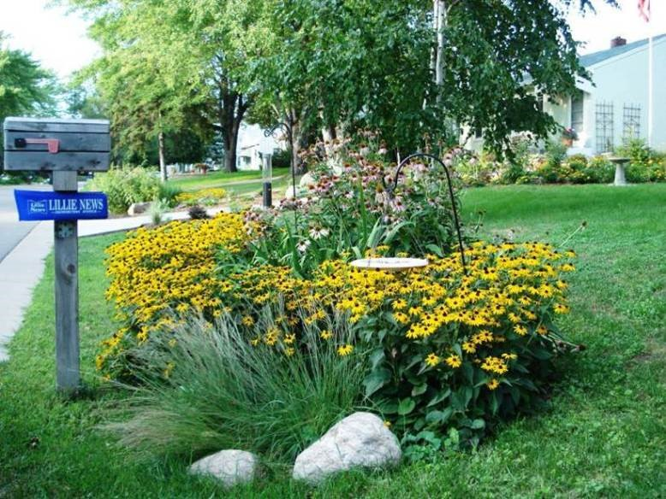
Midwest Permaculture 125 Crescent, Stelle, IL www.MidwestPermaculturecom
0 Feet 35
Flower Garden
Flower Garden

