Slide 1
Example of a Conceptual Design

Slide 2
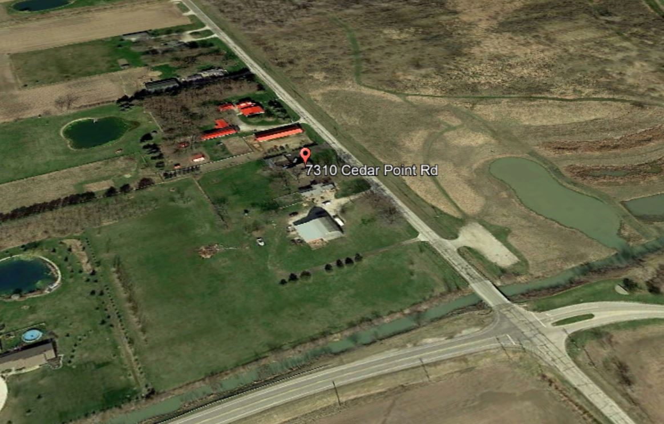
Address

Slide 3
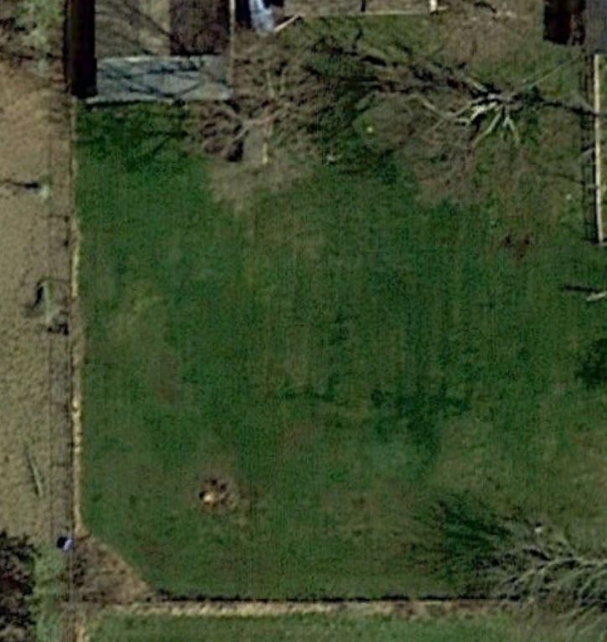
Design Elements to Consider
Implement design in phases beginning this season to begin producing food by next year
Supply more and more of our food for the family
Family learns to do this together
Create habitat/diversity
Floral and faunal beauty all year
Water conservation
Play area for 3 children
Incorporate pockets of native plants
Incorporate some areas for annual vegetable crops
Areas for social gathering (Pergola, firepit)
Possible home-based nutrition coaching business at some point. Property to be demonstration area for clients.
Livestock? Chickens?
Drain Field
Design Area

Slide 4
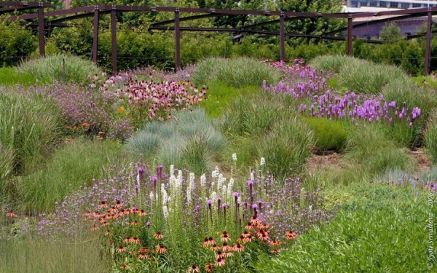
A leach field can be beautiful and functional. With flowering plants all season, it will attract pollinators and add to overall ecological balance to the property.

Slide 5
Leach Field Plants Shallow or Non-aggressive Root Systems
Astilbe Astilibe species
Barrenwort Epimedium species
Barren strawberry Waldsteinia ternata
Beardtongue Penstemon digitalis
Black-eyed-Susan Rudbeckia hirta
Blanket flower Gaillardia species
Blazing star Liatris species
Butterfly milkweed Asclepias tuberosa
Catmint Nepeta racemosa
Columbine Aquilegia species
Cranesbill Geranium species
Daylily Hemerocallis species
Dianthus Dianthus species
Globe thistle Echinops ritro
Goldenrod Solidago species
Hens and chicks Sempervivum species
Hosta Hosta species
Knautia Knautia macedonica
Lamb’s ears Stachys byzantina
Lupine Lupinus species
Moss phlox Phlox subulata
Mullein Verbascum species
Poppy Papaver species
Purple coneflower Echinacea purpurea
Russian sage Perovskia atriplicifolia
Spurge Euphorbia species
Stonecrop Sedum species
Tickseed Coreopsis species
Wild bergamot Monarda fistulosa
Woodland sage Salvia nemerosa
Yarrow Achillea species

Slide 6
Design Area
Drain Field
Design Sequence
Access

Slide 7
Design Area
Drain Field
Design Sequence
Access
Rain Gardens and Spillway Flow

Slide 8
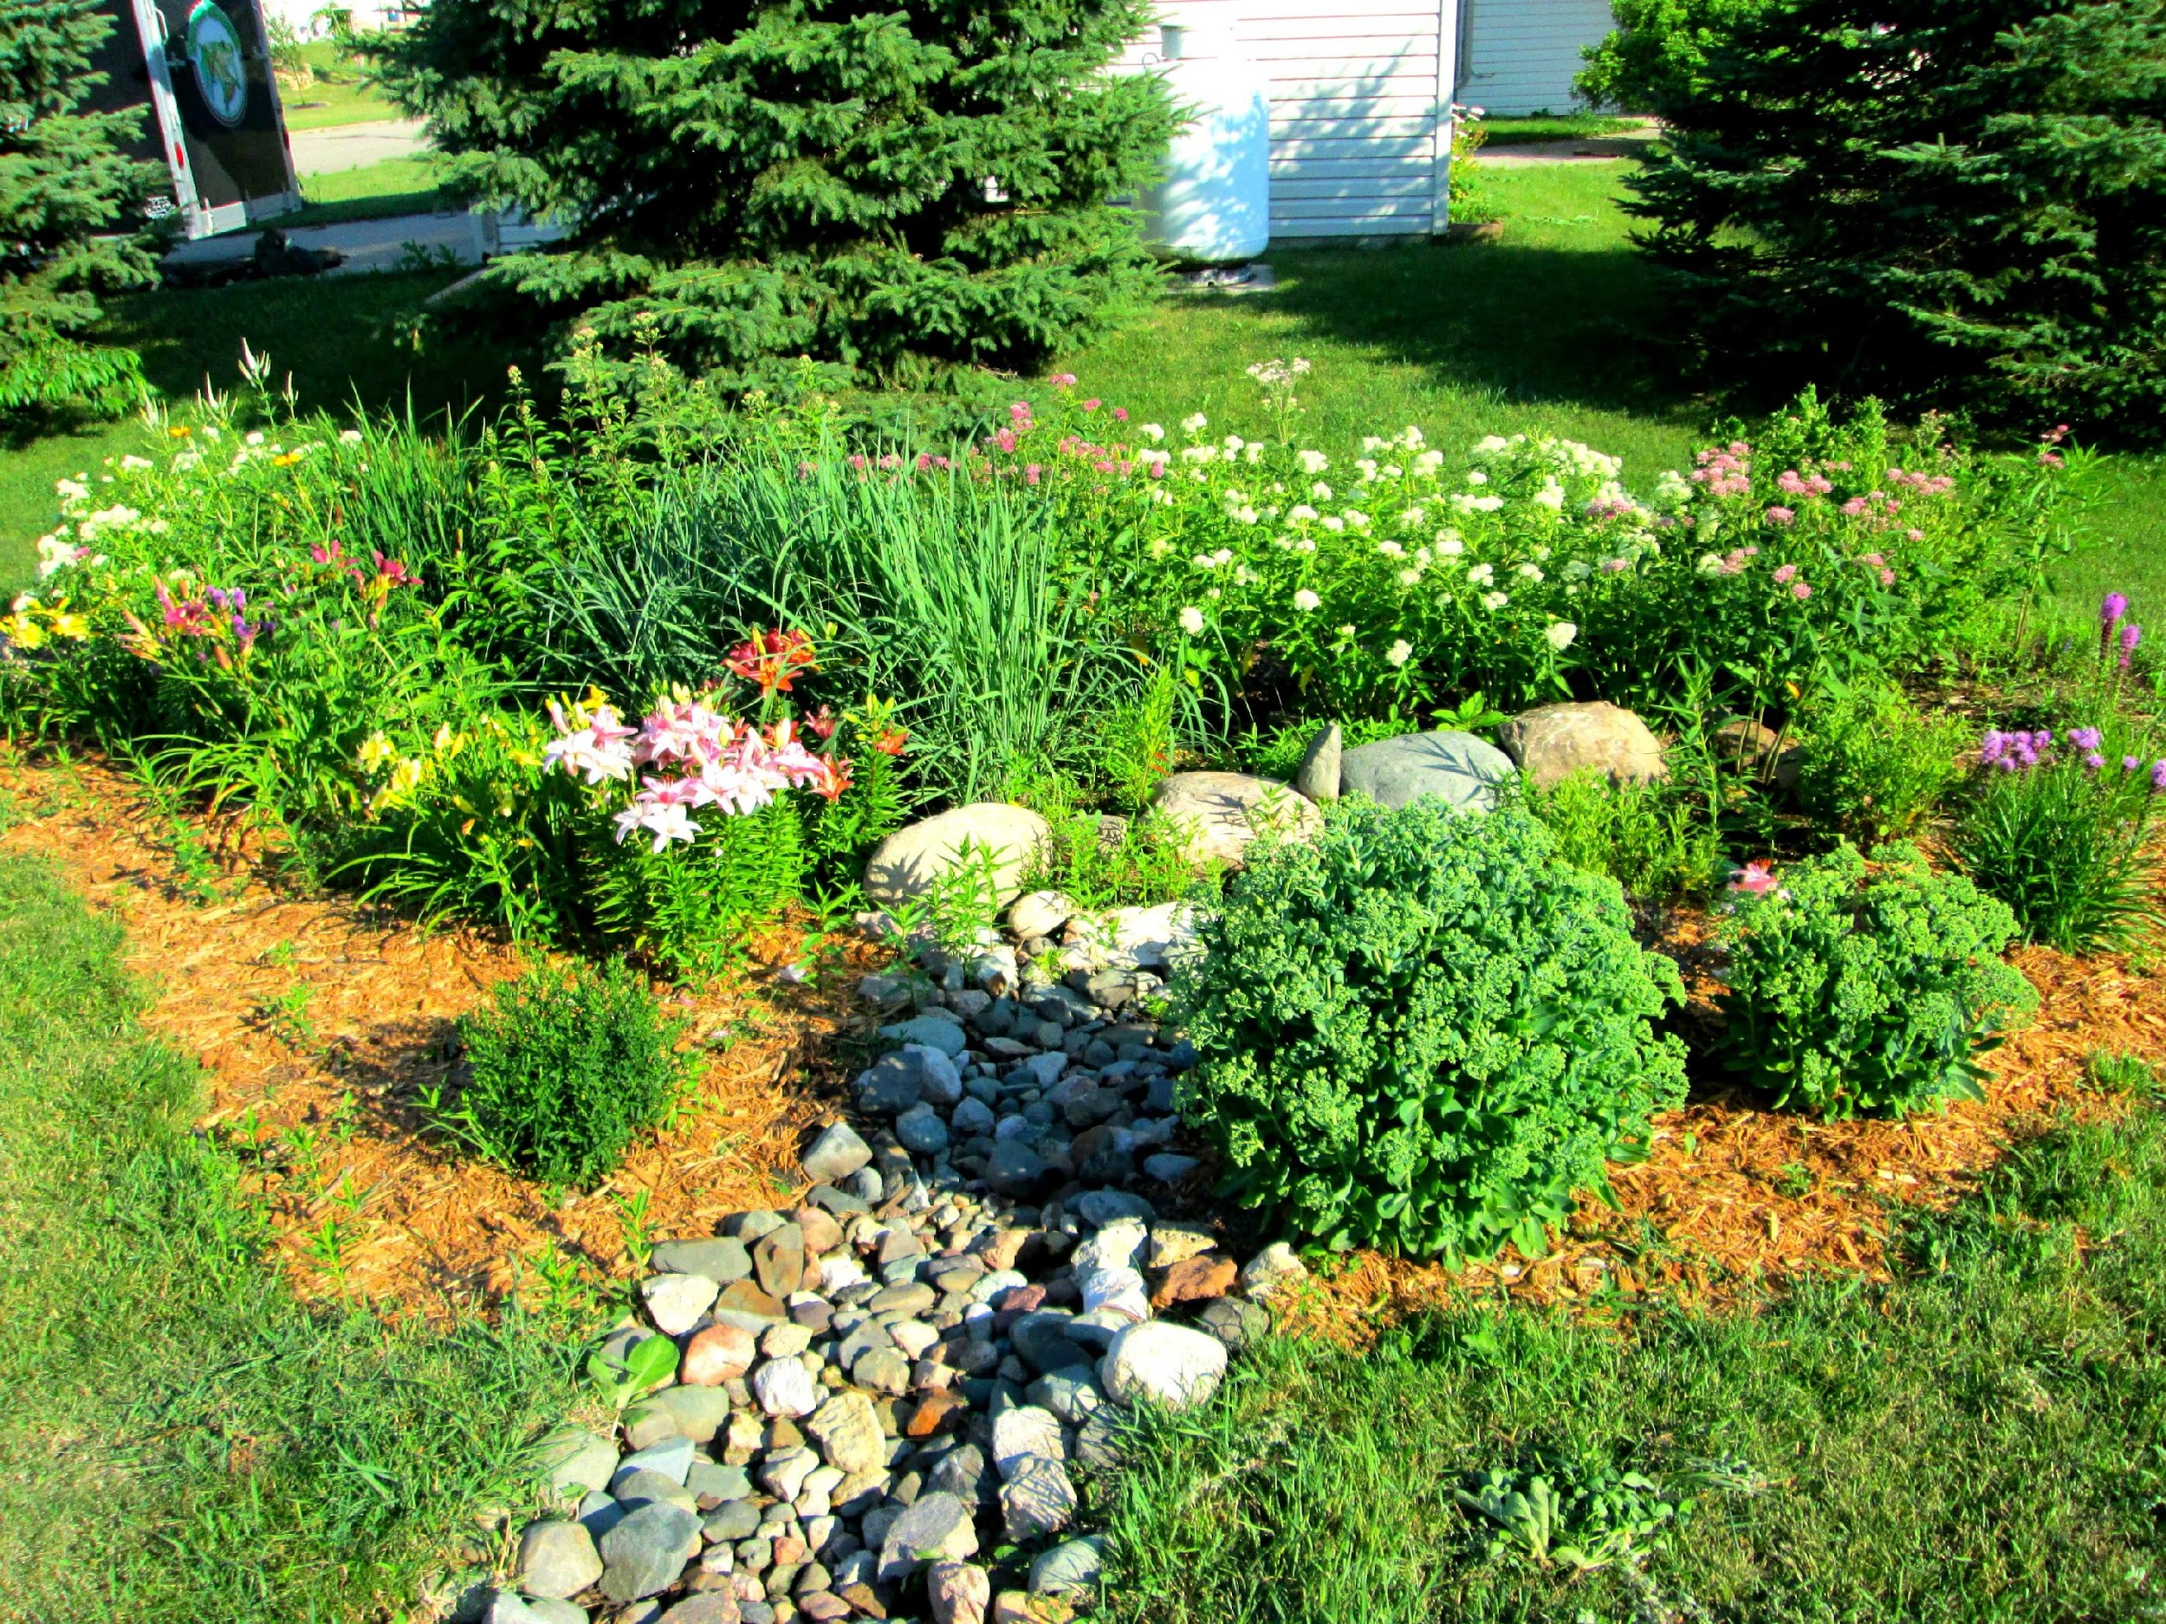

Slide 9
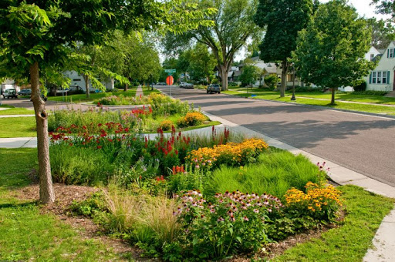

Slide 10
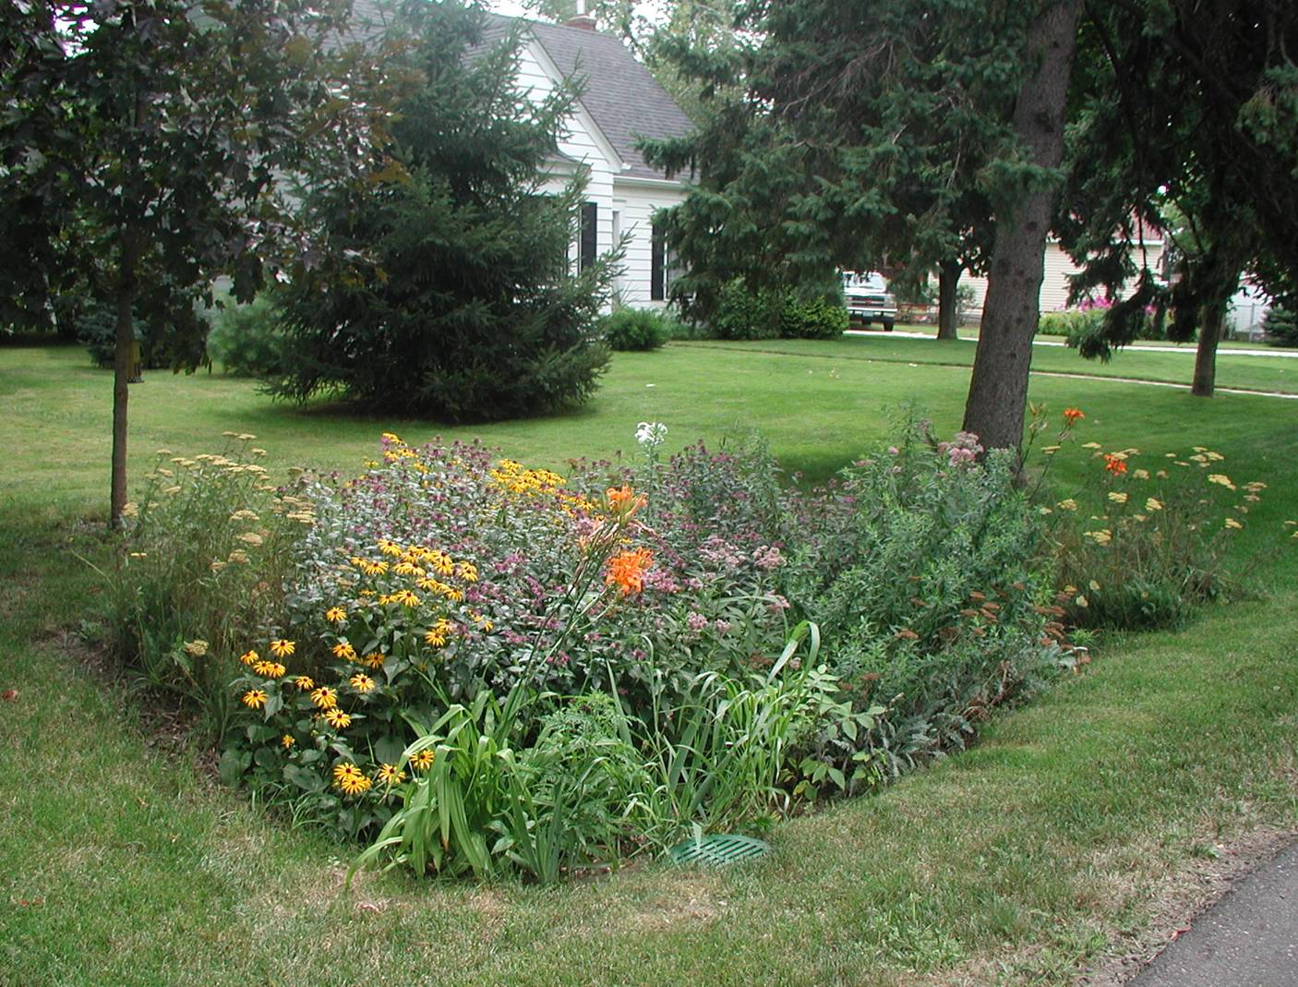

Slide 11
Design Area
Drain Field
Design Sequence
Access
Rain Gardens and Spillway Flow

Slide 12
Design Area
Annual Bed
Drain Field
Design Sequence
Access
Rain Gardens and Spillway Flow
Beds, Hedges and Plantings
Annual Bed

Slide 13
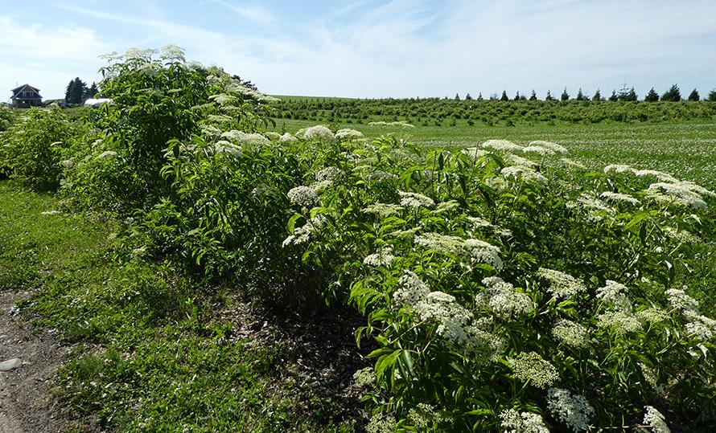
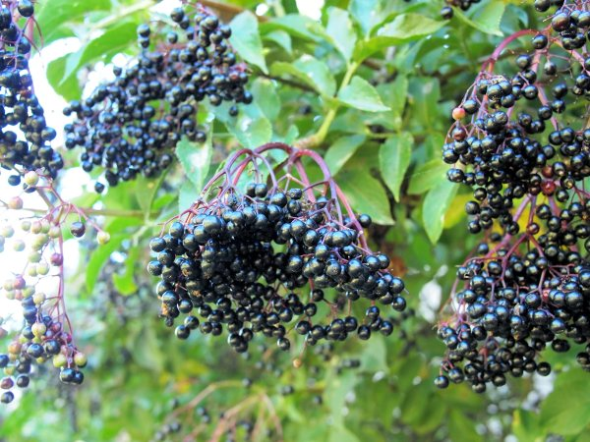
Elderberry – Highly nutritious & medicinal

Slide 14
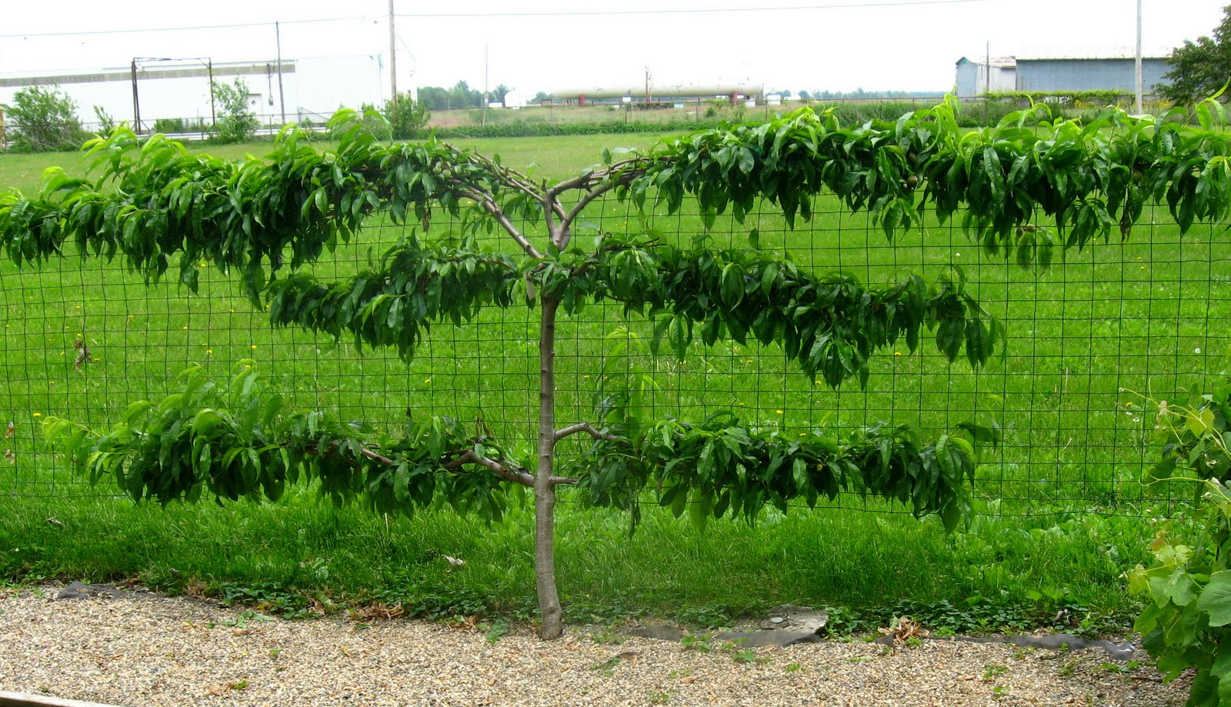
Espalier Fruit Trees Along the Garden Fence

Slide 15
Plant Recommendation
Tolerant of slow draining soils
Fruit Trees
Asian pears
Apples on M111 or
Malus fusca rootstocks
Persimmon
Mulberry (pollard to shape)
Pawpaw (pollard to shape)
Shrubs
Aronia
Hazelnut
Elderberry
Honeyberry
Raspberry
Blackberry
And Possibly (better draining)
Serviceberry
Blueberry
Grapes
Kiwi
Goji
Serviceberry bush
Perennial Veg
Asparagus
Rhubarb
Vines
Akebia (invasive) Choc. Vine
Kiwi
Arguta (10 years)
Silver lining (quick fruiting)
Non-fruiting Trees
Any of the nut trees
Swamp white oak if really wet
Ash
Willow
Austree

Slide 16
Design Area
Annual Bed
Drain Field
Design Sequence
Access
Rain Gardens and Spillway Flow
Beds, Hedges and Plantings
Annual Bed

Slide 17
Design Area
Annual Bed
Drain Field
Design Sequence
Access Paths
Rain Gardens and Spillway Flow
Beds, Hedges and Plantings
Hardscaping: Pergola and Firepit
Pergola
Annual Bed

Slide 18
Review
Drain Field
Design Area

Slide 19
Design Area
Drain Field
Design Sequence
Access

Slide 20
Design Area
Drain Field
Design Sequence
Access
Rain Gardens and Spillway Flow

Slide 21
Design Area
Annual Bed
Drain Field
Design Sequence
Access
Rain Gardens and Spillway Flow
Beds, Hedges and Plantings
Annual Bed

Slide 22
Design Area
Annual Bed
Drain Field
Design Sequence
Access Paths
Rain Gardens and Spillway Flow
Beds, Hedges and Plantings
Hardscaping: Pergola and Firepit
Pergola
Annual Bed

Slide 23
End
Hope this is helpful. Best of luck on your project.
Bill Wilson – Midwest Permaculture

