Slide 1
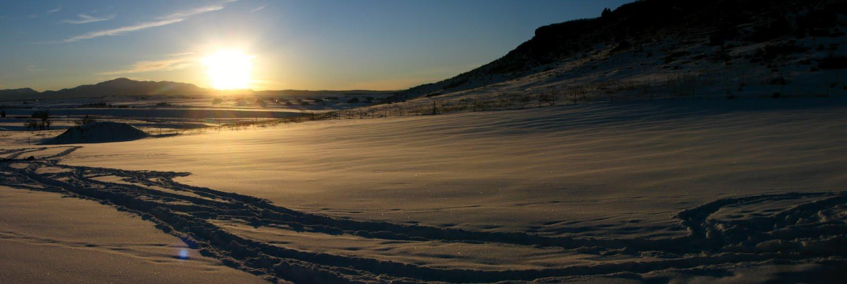
Table Rock Ranch
Permaculture Design Presentation
by Sarah Spotten
Notes:
This photo was taken December 24, 2011 at Table Rock Ranch and shows Table Rock on the right, with Pikes Peak in the background on the left.

Slide 2
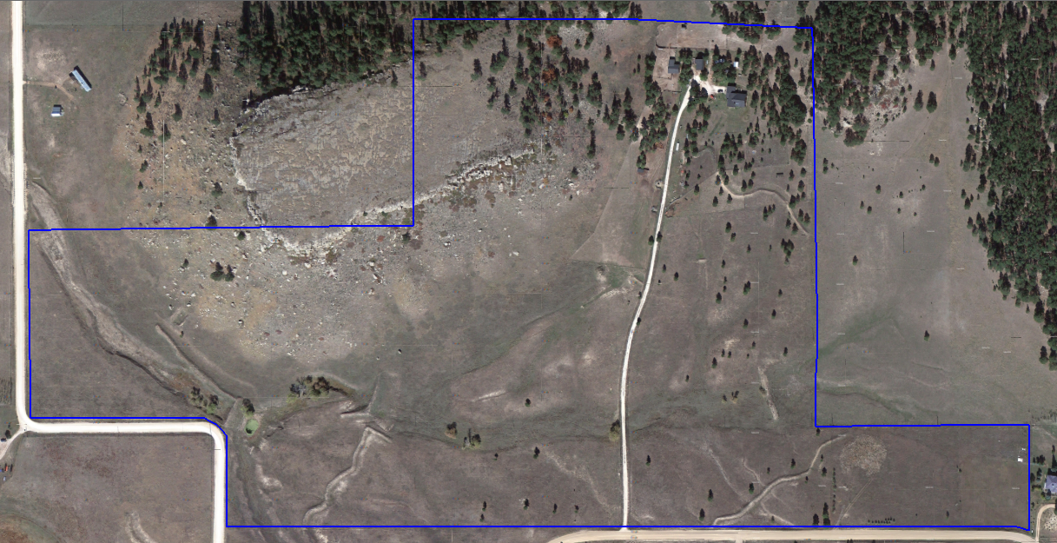
Aerial View of Property
Notes:
Table Rock Ranch, currently under the stewardship of Mike and Win Jenkins, encompasses about 85 acres of high plains land in Colorado's Front Range area. It is at about 7,300' elevation and about 15 miles as the crow flies from the eastern edge of the Rocky Mountains. The ranch is named for a mesa on part of the property called Table Rock, which is an easily-recognizable landmark in the area and which is an important Native American site. There is an authentic Native American medicine wheel on top of the mesa, which is still visited occasionally by members of the Ute nation. Table Rock was a burial site for an important holy man, whose body was exhumed in the mid-20th century. Although it is as yet unconfirmed, Table Rock may be the resting place for several other Native Americans.

Slide 3
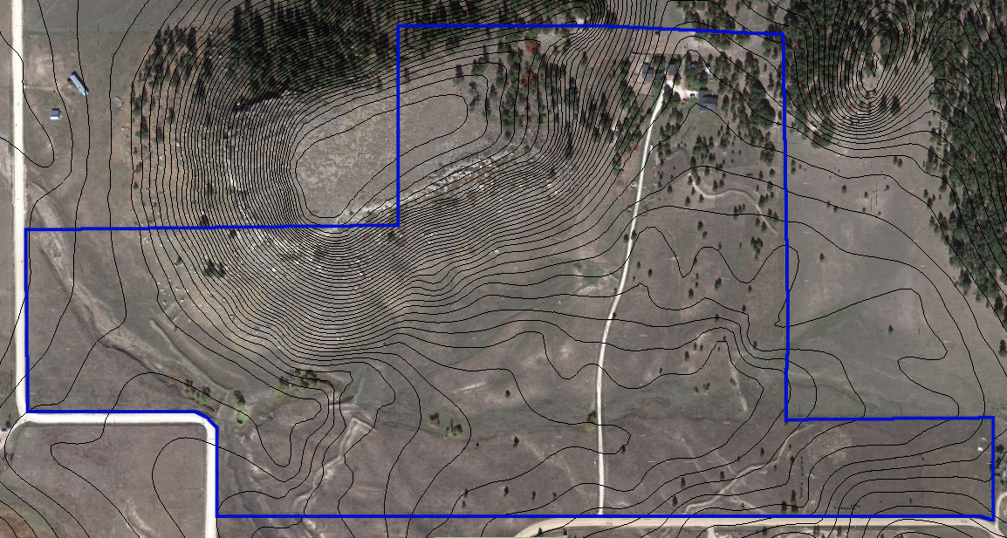
Landform Contours (5' contour lines)

Slide 4
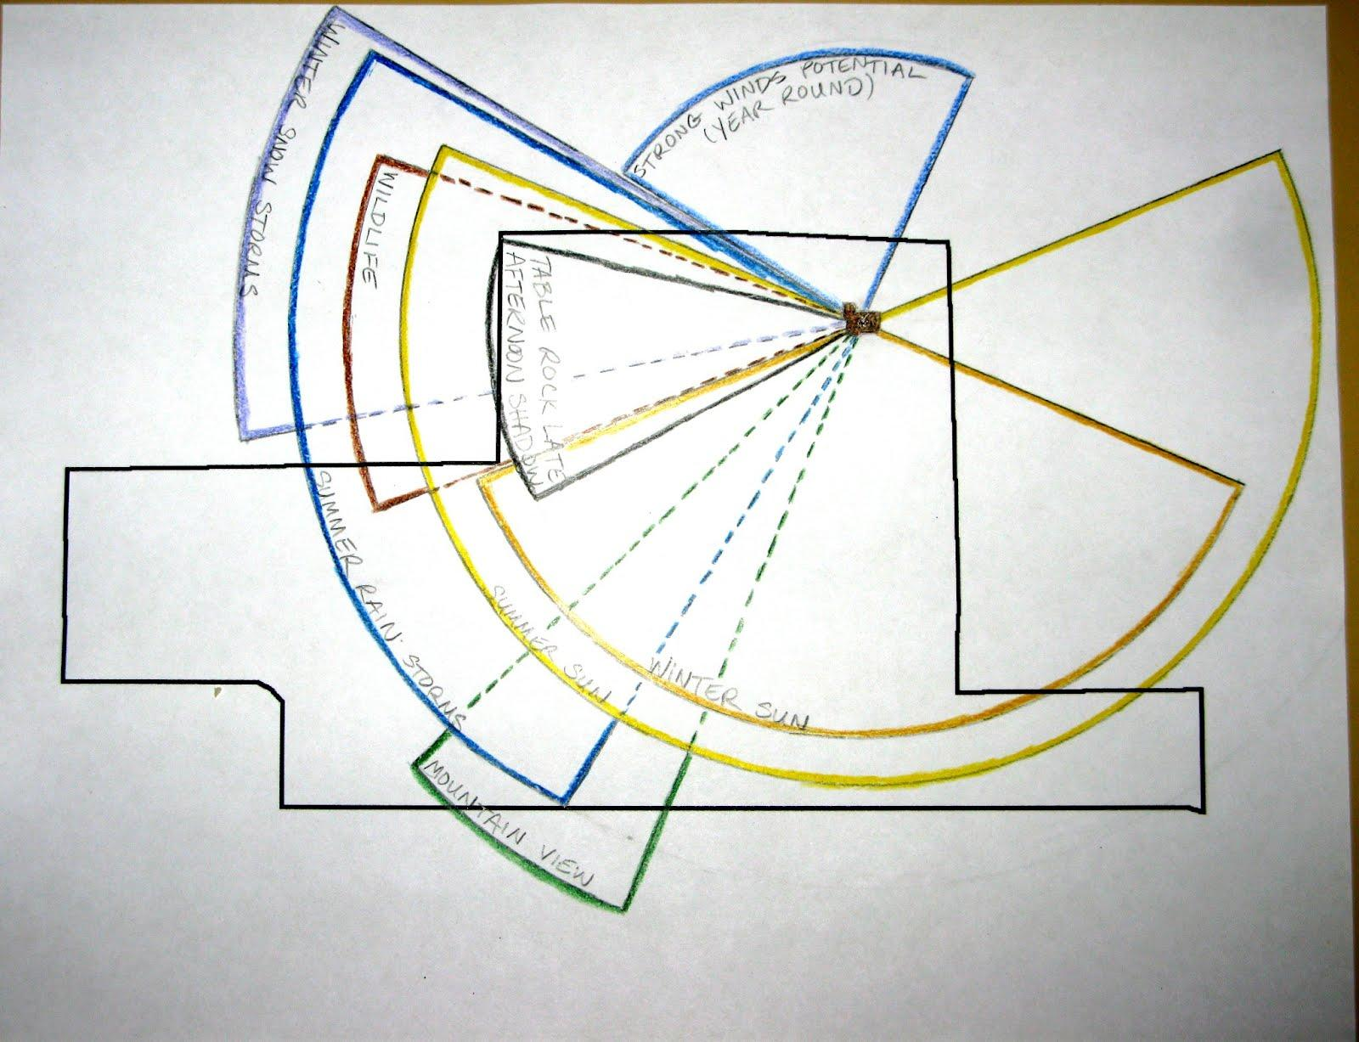
Sector Analysis

Slide 5
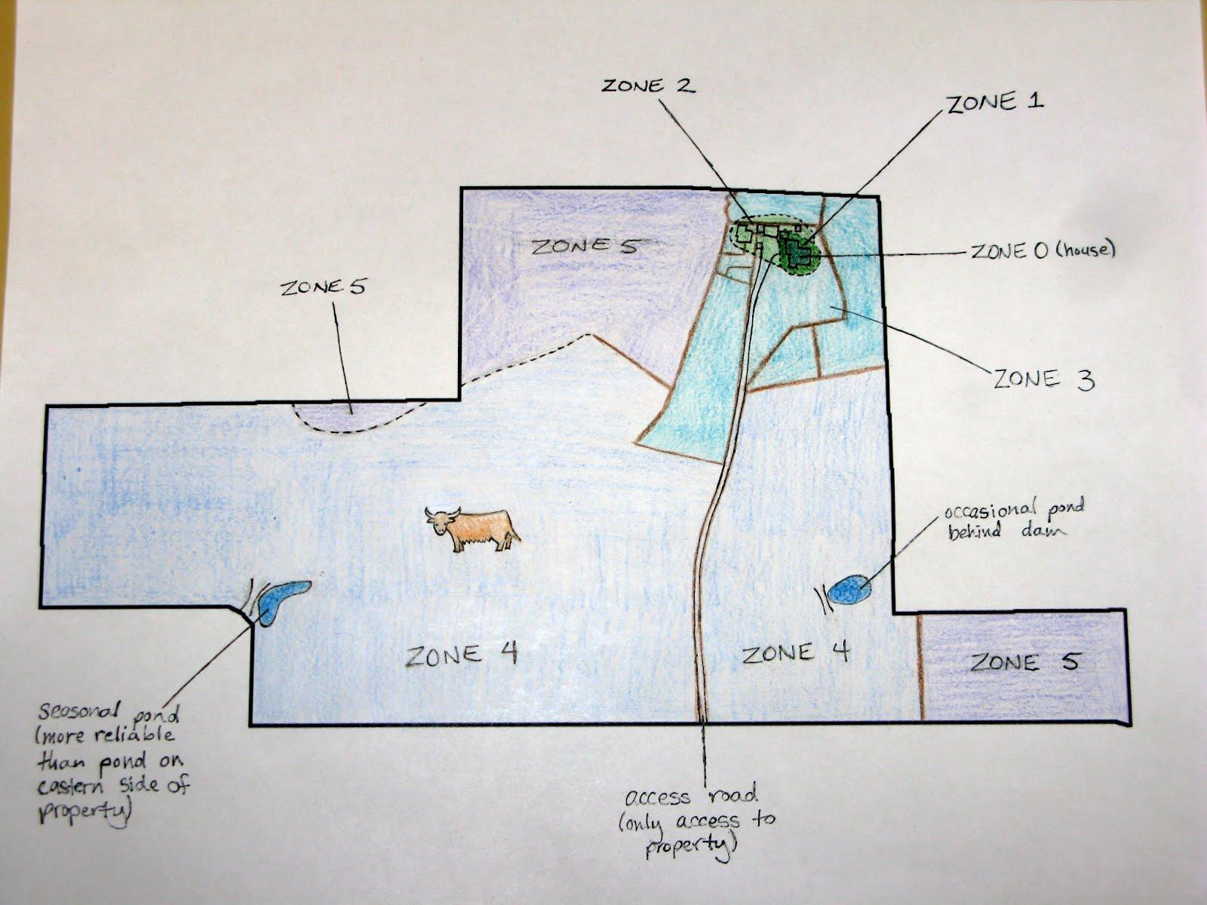
Zones

Slide 6
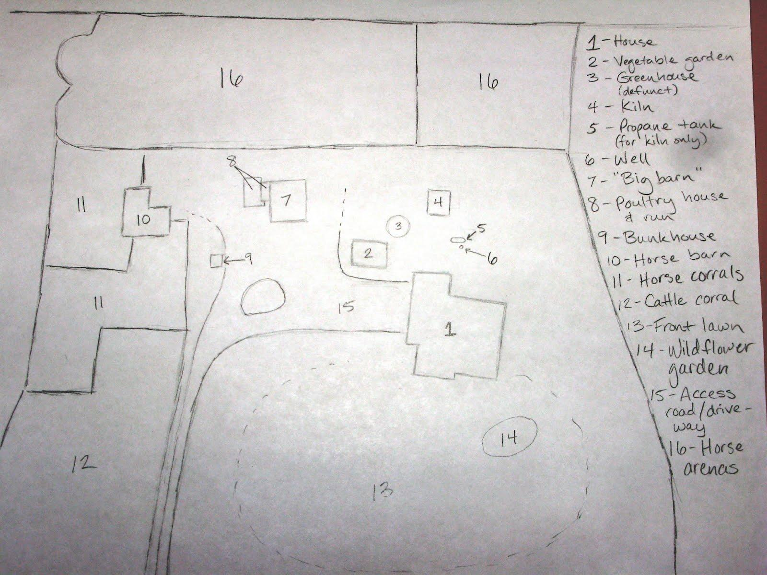
Detail of Zones 1-2

Slide 7
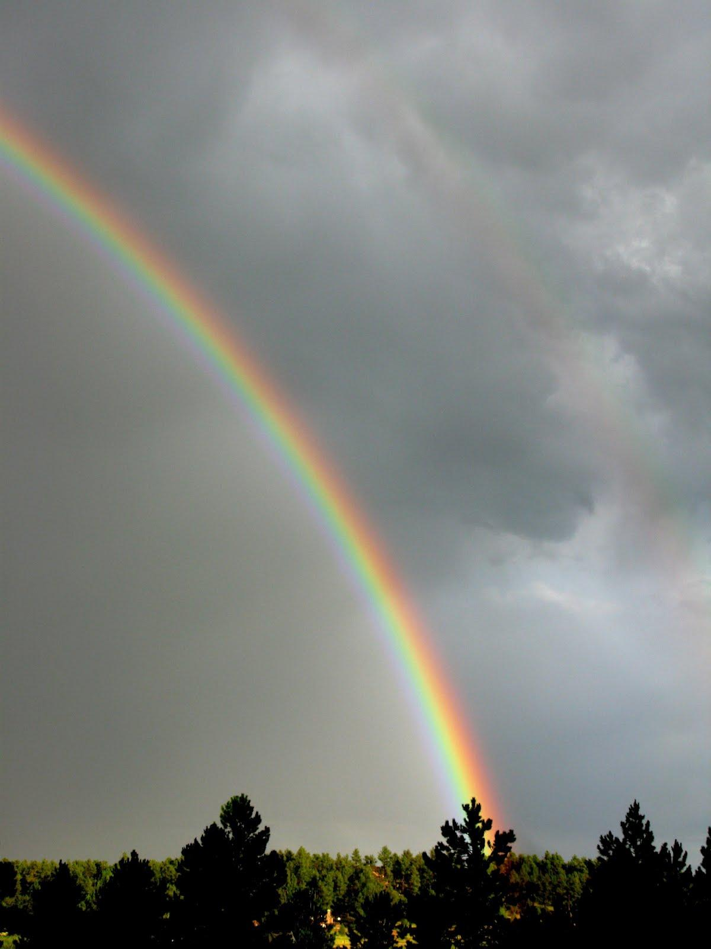
Climate Data
USDA Plant Hardiness Zone: mostly 5a (avg. min. temp. -15°F to -20°F) with some areas of south side of property 5b (avg. min. temp. -10°F to -15°F)
Annual precipitation: 16"
  seasonal distribution: mainly Apr-Sep, with less than 1" in each month from Oct-Mar. Snows mainly occur from Oct-Apr.
Latitude: 39° N
Elevation: 7,365' at home site
Average frost-free dates (32.5°F threshold)
  shortest number of days between frosts: 110
  longest number of days between frosts: 191
Extreme weather potential: drought, severe hail, blizzards, high winds, fire, tornadoes
Notes:
This photo of a double rainbow near Table Rock Ranch was taken after a (very welcome) good amount of rain fell on July 18, 2012.

Slide 8
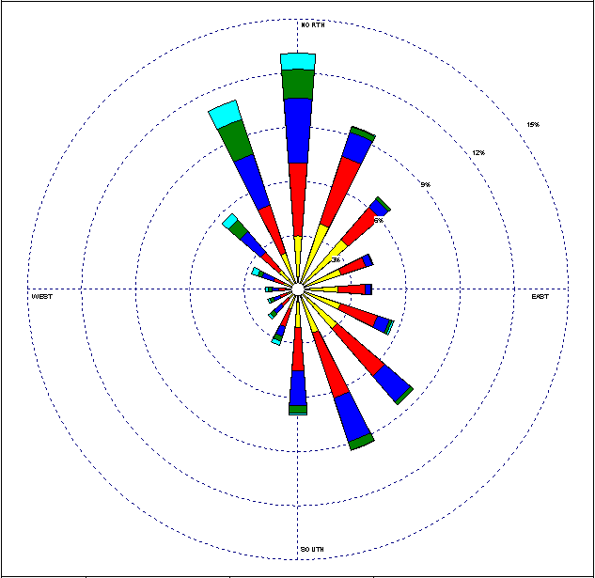
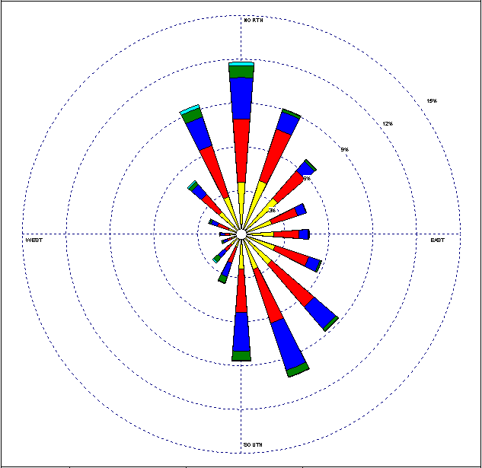

Prevailing Winds - Spring/Summer
March
June
Notes:
The prevailing winds in all four seasons are largely from the north and south. There are few winds that come from the west because of the proximity to the Rocky Mountains.

Slide 9
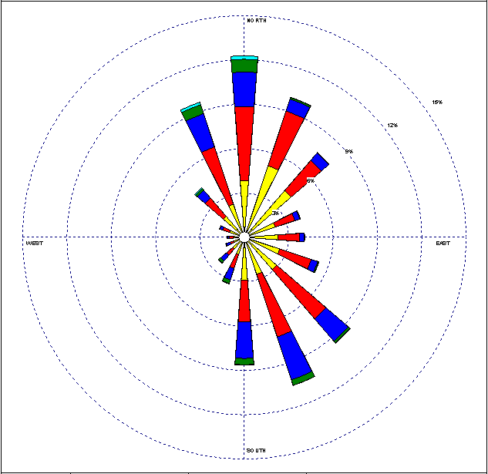
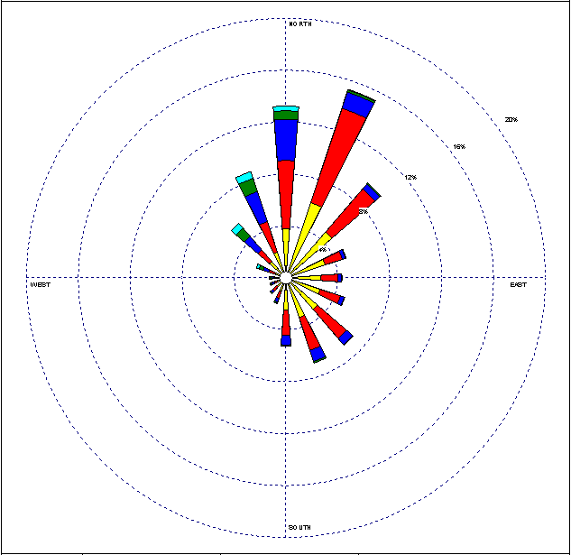
Prevailing Winds - Fall/Winter
September
December

Slide 10
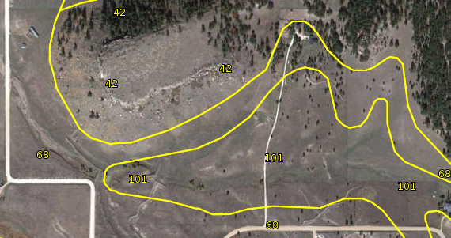
Soil Map
42 - Kettle-Rock outcrop complex: 60% sandy, low organic matter soil; 20% rock outcrops
68 - Peyton-Pring complex, 3 to 8% slopes: loamy, well-drained alluvium weathered from sedimentary rock, up to nearly 3% organic matter
101 - Ustic Torrifluvents, loamy: sandy, clayey, loamy, well-drained soil built from runoff

Slide 11
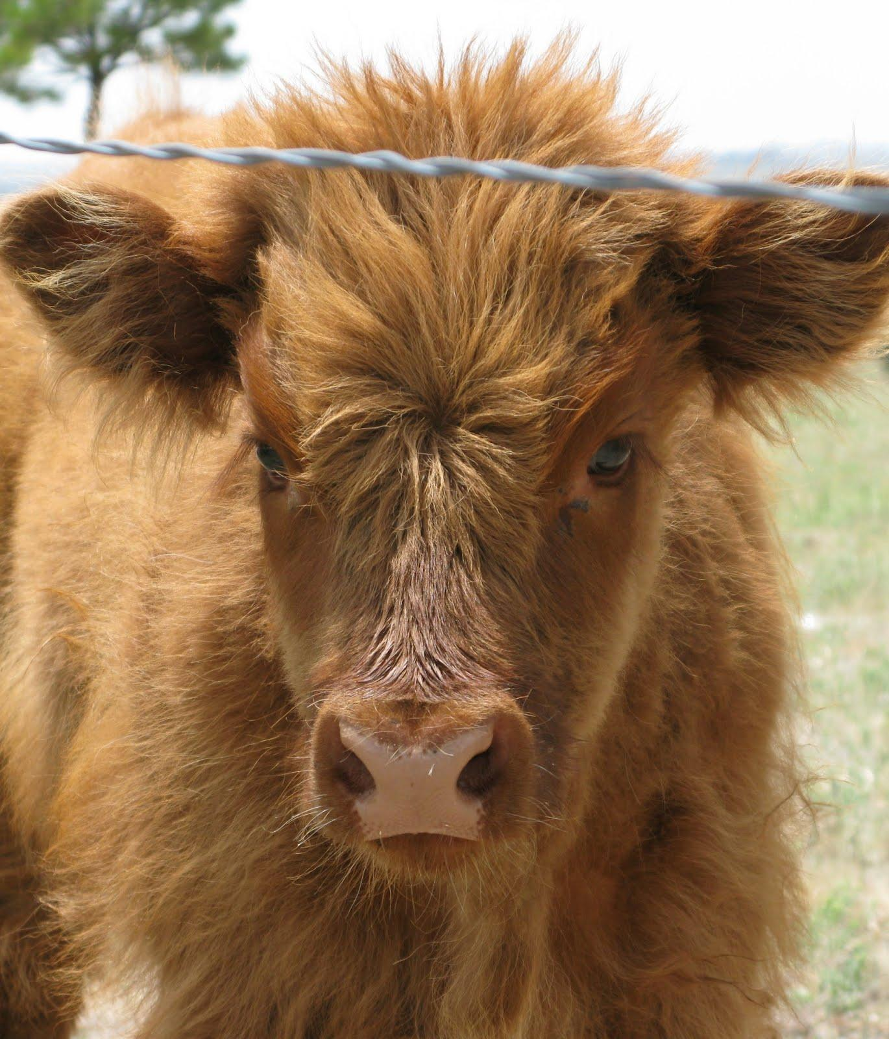
Current Land Use
Grazing Scottish Highland cattle (heritage beef breed raised for specialty market - main crop for Table Rock Ranch, allows it to keep ag status for taxes)
Grazing horse, mule, and miniature donkey
Summer vegetable garden
Large lawn area for gatherings
Summer wildflower garden
Table Rock (Zone 5) left to nature, important Native American site

Slide 12
Overall Permaculture Design Goals
Keep energy on property in cyclical flows
Build the land's capacity to support life
Provide for inhabitants to be more self-reliant and less dependent on fossil-fueled trips into town

Slide 13
Leverage Points
Composting system
Garden design & companion planting
Seed saving
Season extension
Food preservation
Pasture-building
Preserving Table Rock as a Zone 5 space for nature and future generations
Notes:
My goal in this design is to have attainable goals and use techniques that could easily be implemented by Mike and Win right now. For this reason, I did not delve into large, whole-property designs that might have been overwhelming and insurmountable, but focused on making smaller changes to the current system that would bring the greatest immediate benefits, or on goals that have already been voiced by Mike and Win.

Slide 14
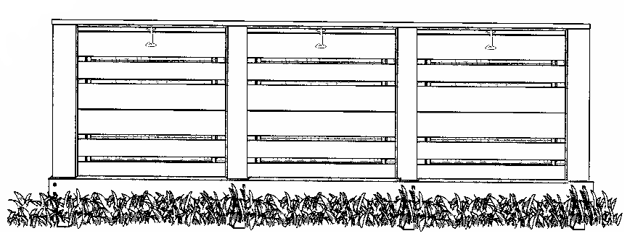
Composting System
Current situation: Kitchen scraps (those that don't go to the poultry) often go out with the garbage, sending nutrients that could be used to build soil off the property permanently. Green waste from the yard is piled behind the garden.
Design goals:
Recycle nutrients in food waste into highly-productive soil for growing more food in turn
Plans:
Build easily-accessible compost box system adjacent to the garden in the green waste space
Use a kitchen compost jar (which Mike, who is a potter, already makes) for temporarily storing food scraps until they can be conveniently taken out to the compost

Slide 15
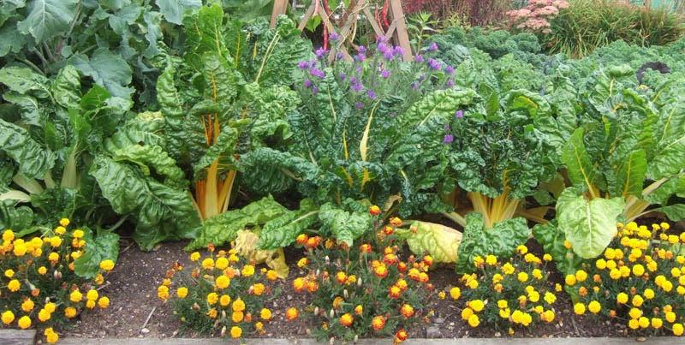
Garden Design & Companion Planting
Current situation: The garden is planted in north-south rows running downhill. Plants are planted in single-species blocks. The soil is tilled every year and aged cow manure tilled in. The garden is watered by well water and by what rain falls.
Design goals:
Maximize yield and minimize pest damage by interplanting and companion planting
Redesign garden to use curves, edges, maximize sun exposure and better retain water
Plans:
Implement on-contour row-swales, keyhole beds, or a combination of both
Plan plantings to take advantage of beneficial relationships between species
Interplant useful non-food plants in garden to attract beneficial insects, repel pests, accumulate nutrients in the soil
Mulch heavily to retain water and alleviate need for tilling
Possibly implement hugelkultur beds

Slide 16
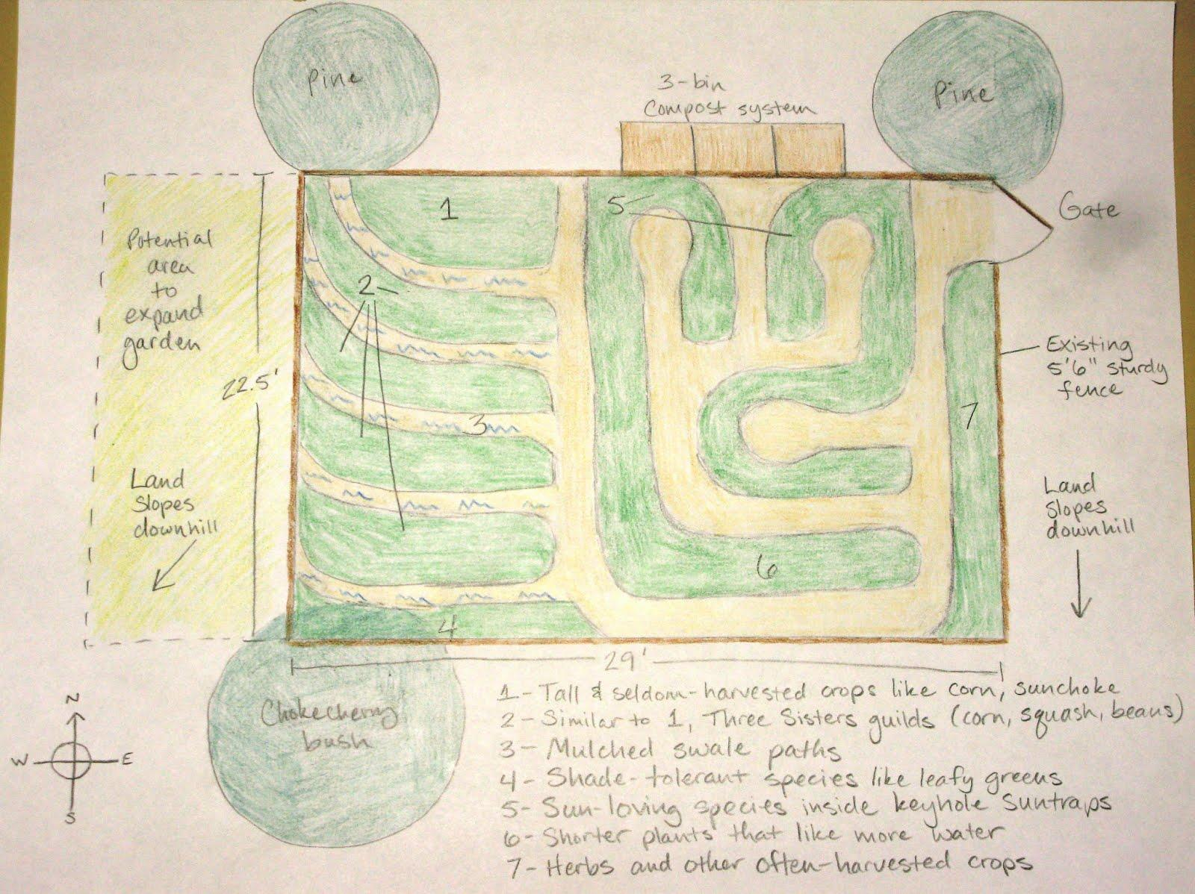
Garden Redesign w/Compost System

Slide 17
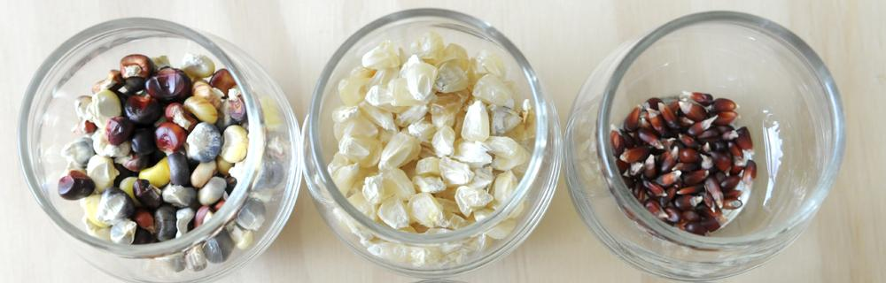
Seed Saving
Current situation: Seed packets and started plants are bought anew every year for the garden. Seeds from packets may be less appropriate for the local growing situation than varieties developed and saved by Front Range gardeners.
Design goals:
Save money spent annually on seeds and starts
Over time, develop plants that are hardy to the local conditions
Plans:
Get starter seeds next season from the Manitou Seed Library (locally-adapted heritage varieties) - motivation for seed saving (part of the obligation of "borrowing" seed from the library)
Plan planting times and places to maintain genetic integrity of saved seed, for example planting both early and late-maturing varieties of crops like cucurbits to stagger pollination times
Save seeds!

Slide 18
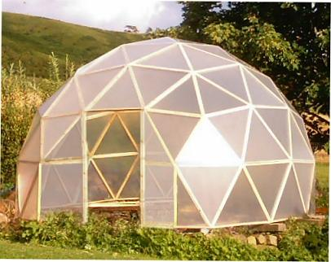
Season Extension
Current situation: The Front Range growing season is limited to about four months from May to September. The Jenkins' garden is only in production during that window (from last frost to first frost), although a tomato plant and some lettuces are sometimes grown indoors in containers after the first frost. For the remaining eight months of the year, food largely comes from the grocery store.
Design goals:
Lengthen the season for fresh and healthy garden produce
Reduce grocery bills and trips to town
Plans:
Revamp or rebuild the defunct greenhouse to withstand Colorado's severe hail (which is what damaged it in the first place)
Create hoop houses to extend season for crops like lettuces, brassicas, carrots, green onions, radishes, cilantro, bok choy, etc.
Plant both early and late-maturing varieties of the same crop to extend the harvestable period

Slide 19
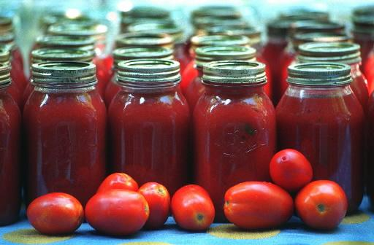
Food Preservation
Current situation: Meat from the beef cattle is preserved year-round in a freezer, but garden produce is rarely preserved for later use. The garden generally only grows enough food to be eaten fresh during the summer months. For the remaining eight months of the year, food largely comes from the grocery store.
Design goals:
Reduce grocery bills and trips to town
Eat from the home garden year-round - if not fresh, then from preserved produce
Plans:
Expand the garden's size to produce enough food to last through the winter via preserving
Preserve food (start with freezing since there is already a freezer in use, then gradually replace freezing with more sustainable methods like canning, drying, fermenting and root cellaring)

Slide 20
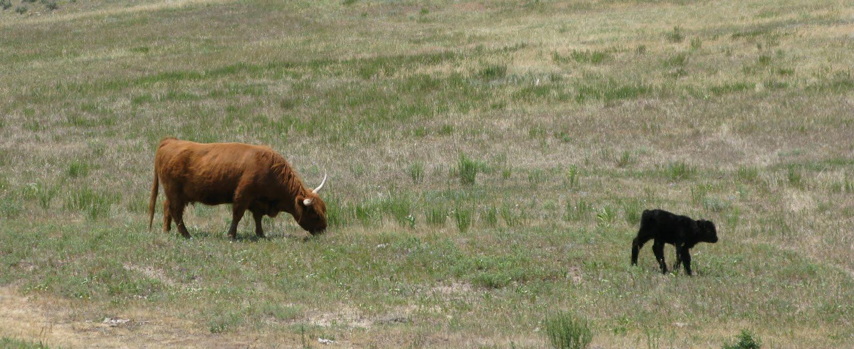
Pasture-building
Current situation: The pastures are declining in quality after being continuously grazed and compacted by cattle for 20+ years - grass is being replaced by weedy plants unpalatable to cattle. This, coupled with continuing drought have meant that the cattle have to be fed with hay for a greater and greater part of the year (not just winter), which is getting more expensive as hay prices rise (also due to drought).
Design goals:
Rebuild the health of the pastures and their capacity to sustain themselves like the prairie grassland native to this area
Reduce livestock feed bills and energy needed to bring feed onto the property
Plans:
Utilize P.A. Yeomans' Keyline Plowing Method and seed the following grass species suggested by CO State University (http://www.colostate.edu/Dept/CoopExt/Adams/sa/gsefrc.htm): Slender wheatgrass, 0 to 10% of the mixture; western wheatgrass, 20 to 45%; sideoats grama, 20 to 40%; blue grama, 10 to 25%; green needlegrass 5 to 30%; prairie sandreed, 10 to 30%; sand bluestem, 20 to 35%; little bluestem, 0 to 10%
Reduce, rotate, and possibly change species of livestock from year to year
Implement mob grazing (fencing in livestock to small areas, grazing hard, then moving fence and livestock to a new area, rotating around pastures)
Notes:
The grass species recommended by CO State University for pastures on the Eastern Front Range (which is where we are) are drought-tolerant and known as "cold season" species. Some are natives and others are introduced fodder species.

Slide 21
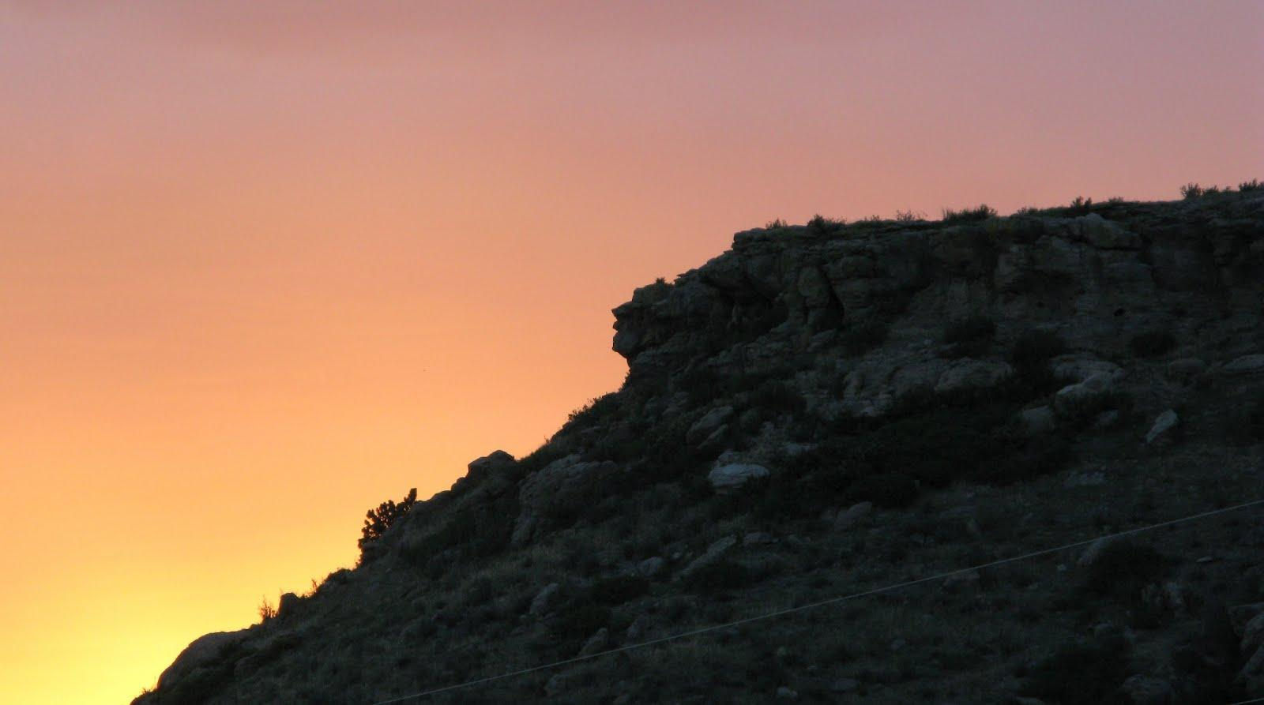
Preserving Table Rock
Current situation: Table Rock is currently left to nature and used by humans only as a place to contemplate. It is a dry, fragile environment and a haven for wildlife in a landscape that is being built up all around them. It is also a sacred Native American site with an authentic medicine wheel which is still visited by members of the Ute nation - and it was formerly the burial site of a Native American holy man. It may be the resting place of other Native Americans. However, Table Rock is currently not protected from being built upon by a future owner of the land (it would be a very enticing [though unsustainable] homesite for someone concerned with having a prime view - other mesas and high spaces in the neighboring area have already been built upon).
Design goals:
Preserve Table Rock for nature and future generations as a Zone 5 space
Preserve the integrity of the adjacent environment (preventing the runoff erosion that would probably result from building on top of Table Rock, for example)
Plans:
Repatriate holy man's body to his original resting place on Table Rock
Confirm existence of other gravesites on the mesa
Get Table Rock protected from development by U.S. law under the Native American Graves Protection and Repatriation Act
Notes:
Look closely at this photo of Table Rock at sunset and you can see what looks like the profile of a Native American man's face in the rocks!

Slide 22
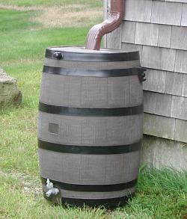
Forward Thinking
Where could this design go in the future?
Collecting rainwater - now legal in Colorado if you have a permit and use a well
Building a rain garden(s) off the south side (downslope) of the house
Implementing a greywater system(s) to recapture water for toilets, garden irrigation
Notes:
Colorado is a semi-arid state and is currently in the midst of a years-long drought, so water is going to be a key priority for this design in the future, in order to ensure its sustainability.

Slide 23
What I Learned from This Process
The problem is the solution:
  kitchen scraps that otherwise go to waste can, though several biological processes, become food again
  the pasture is already trying to rebuild itself, as evidenced by the weeds, we just need to help it along in its process of succession
The importance of observation cannot be overstated - at first a problem and its solution may look simple, but we must look at the situation from a holistic perspective to really understand the appropriate action to take
Notes:
Two ideas that are oft-repeated by permaculturists, but are not at all cliched! On observation: it would have been easy to "go crazy" with the design for this 85-acre parcel and turn it into the ultimate permaculture Eden, but observing the landscape also means observing the people who already live there, and their willingness and ableness (physical and/or financial) to turn the design into reality.

